Slide 1
Synchrotron emission in Alcator C-Mod: Spectra at three B-fields and visible camera images
A. Tinguely¹, R. Granetz¹, M. Hoppe², O. Embréus², A. Stahl², and T. Fülöp²
Runaway Electron Meeting 2017
Prague, Czech Republic
¹MIT Plasma Science and Fusion Center, Cambridge, MA, USA
²Chalmers University of Technology, Gothenburg, Sweden

Slide 2
Outline
Runaway electron synchrotron spectra measured at three magnetic fields
Visible camera images of synchrotron emission and comparison with SOFT
Radial profiles of synchrotron radiation polarization
Questions

Slide 3
Outline
Runaway electron synchrotron spectra measured at three magnetic fields
Visible camera images of synchrotron emission and comparison with SOFT
Radial profiles of synchrotron radiation polarization
Questions

Slide 4
Alcator C-Mod – a high-field, compact tokamak
B₀ $≤$ 8 T, I_{P} $≤$ 2 MA, $\left\langle p\right\rangle ≤$ 2 atm (0.3 MJ/m³), R₀ = 0.68 m, a = 0.22 m
Equipped with extensive disruption-relevant diagnostics
C-Mod permanently shut down last year

Slide 5
Runaway video

Slide 7
Motivation: Runaways can cause serious damage
Runaway electrons (REs):
Energies $>$ 10 MeV
In C-Mod, I_{RE} << I_{P} during plasma flattop
Severely damage plasma-facing components
It is necessary to understand the evolution of REs in both momentum space and real space to effectively avoid and mitigate them.

Slide 8
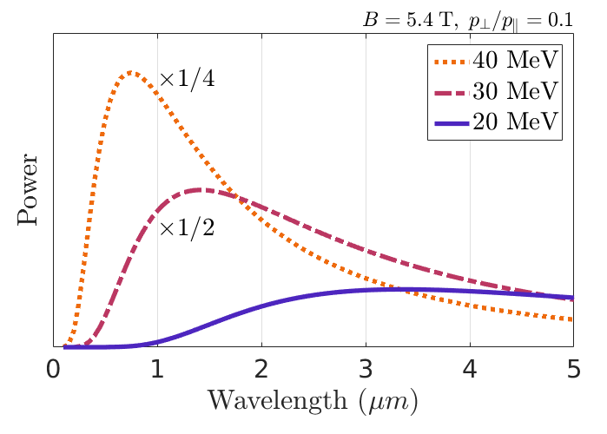
Does synchrotron radiation limit REs maximum energy?
I.M. Pankratov, Plasma Phys. Reports 25 (1999)

Slide 9
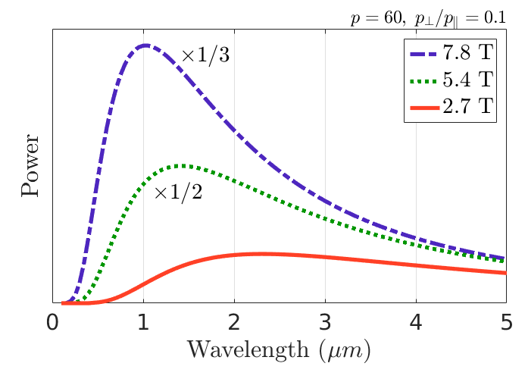
Does synchrotron radiation limit REs maximum energy?
I.M. Pankratov, Plasma Phys. Reports 25 (1999)

Slide 10
Absolutely-calibrated spectrometers measure emission
Top
View

Slide 11
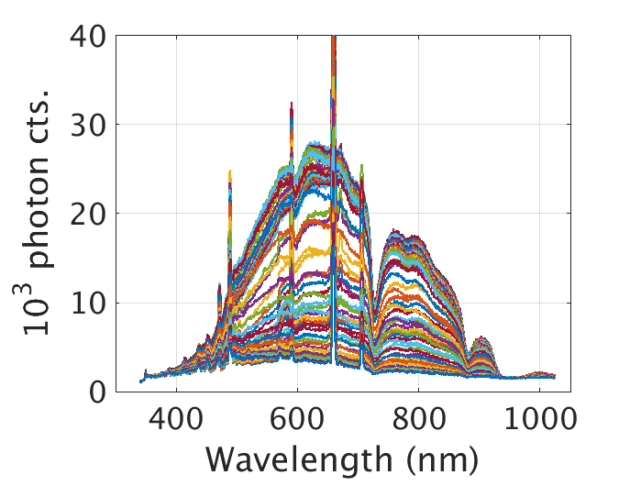
Absolutely-calibrated spectrometers measure emission
1160902016
Top
View

Slide 12
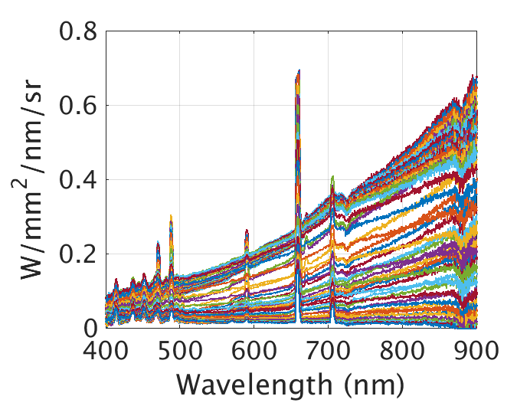
Absolutely-calibrated spectrometers measure emission
1160902016
1160902016
Top
View

Slide 13
7.8 T
5.4 T
2.7 T
1160824024 1160824026 1160902016

Slide 14
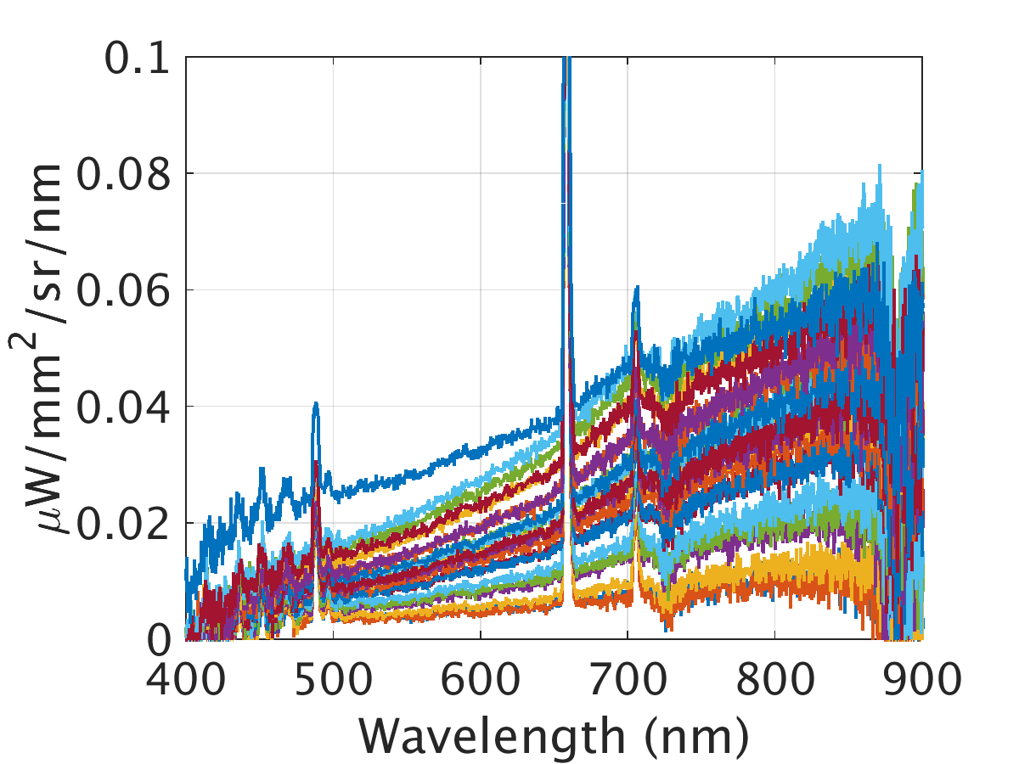
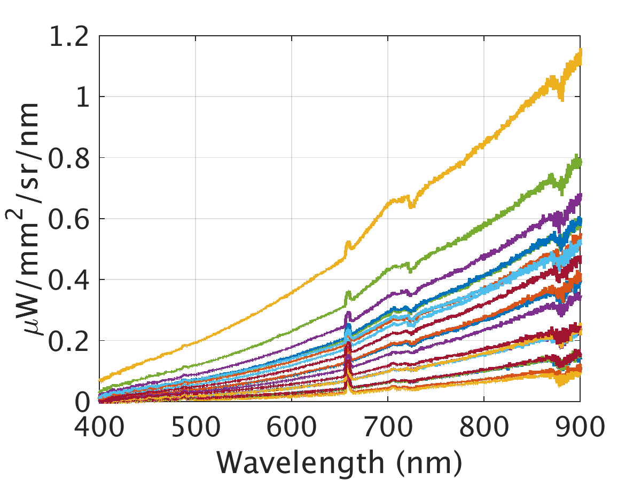
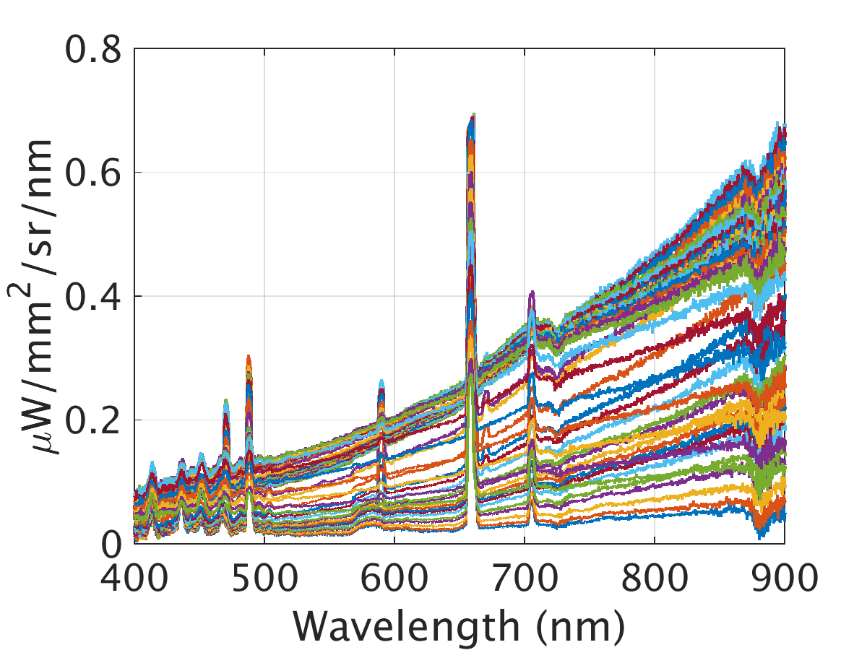
Synchrotron spectra measured at three B-fields
RE densities are difficult to reproduce, so we are not interested in the absolute amplitude.
Instead, we are interested in the spectral shape.
2.7 T
5.4 T
7.8 T
1160824024
1160824026
1160902016

Slide 15
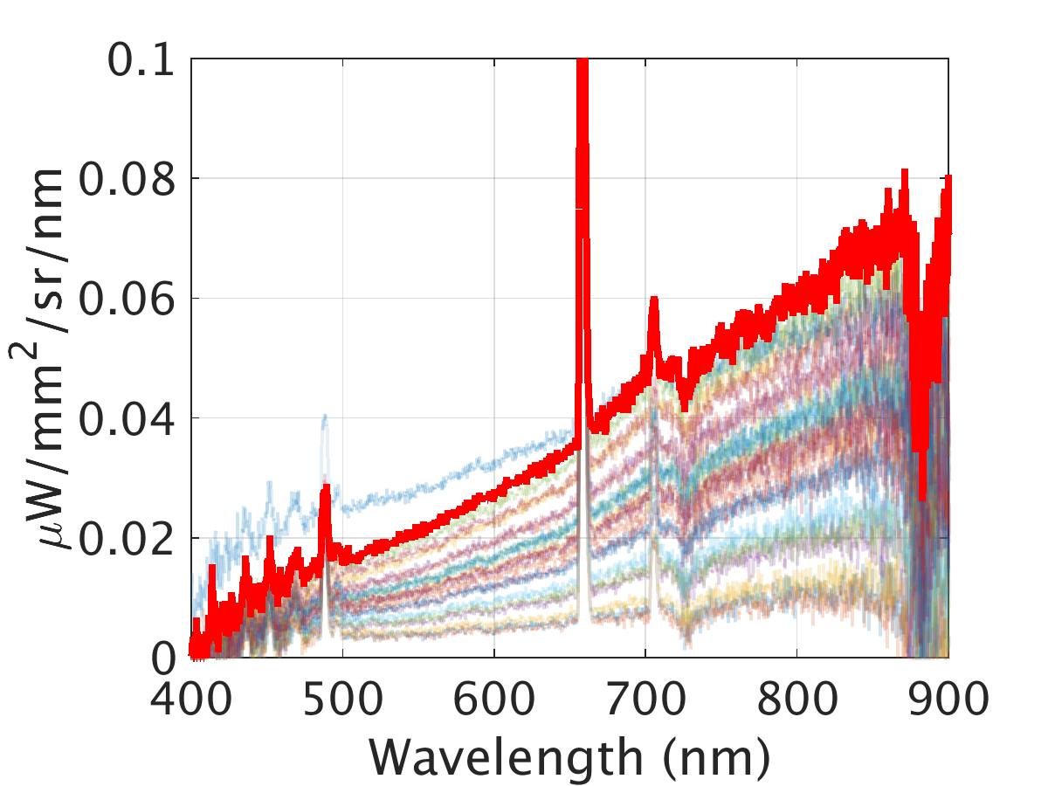
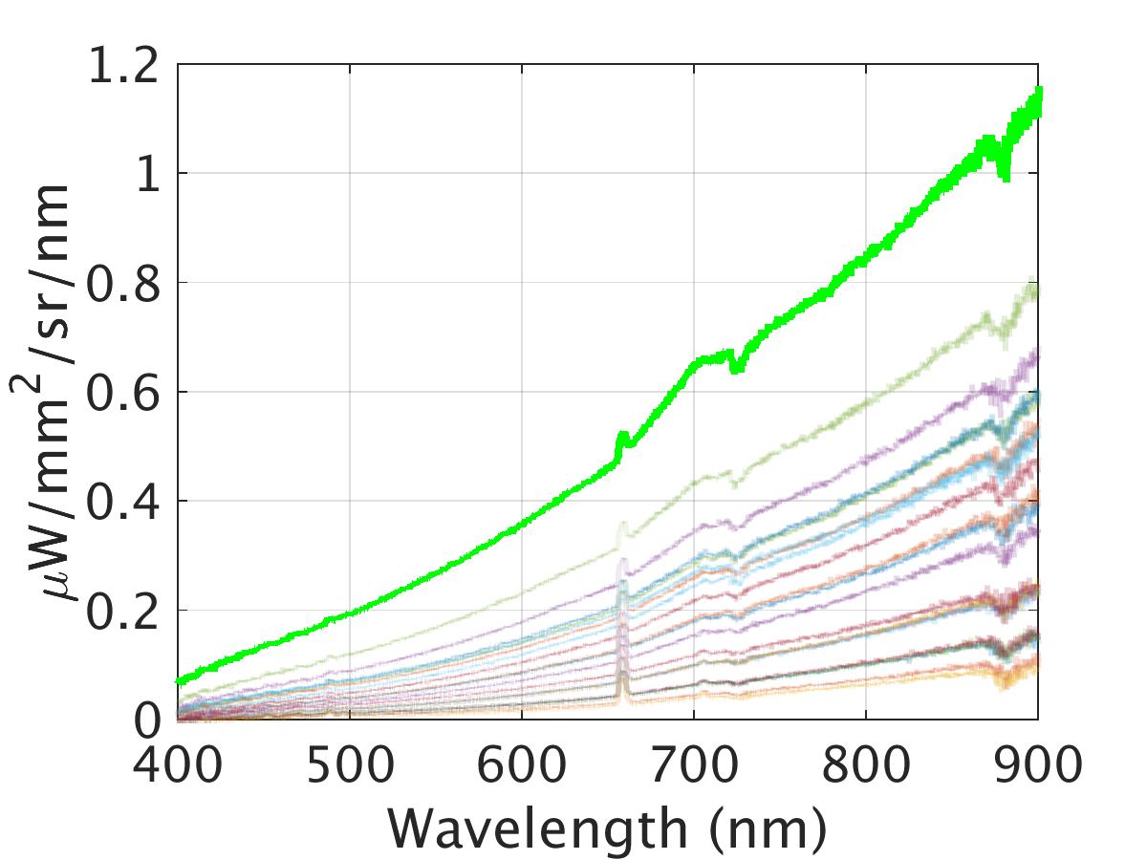
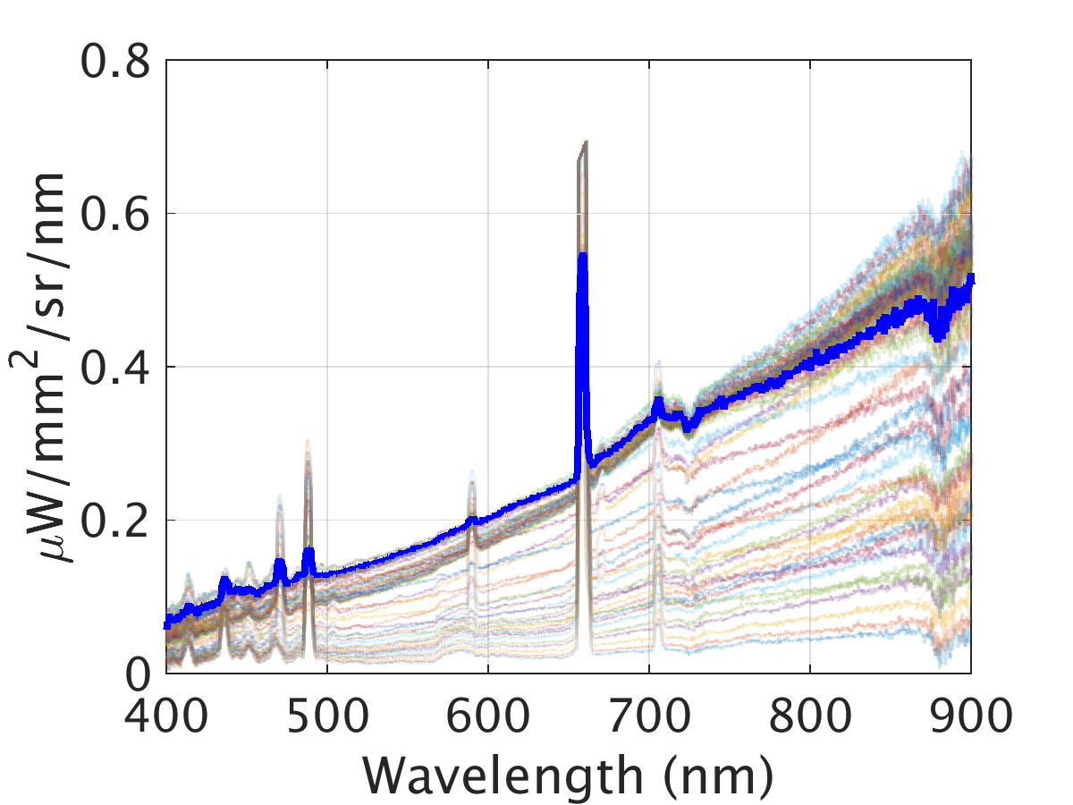
Synchrotron spectra measured at three B-fields
Select one time-slice near maximum emission during steady plasma parameters.
Take the ratio of two spectra and normalize at one wavelength.
2.7 T
5.4 T
7.8 T
1160824024
1160824026
1160902016

Slide 16
Comparison of spectra
*Relative to the reference spectra
Positive slope
More brightness at longer wavelengths
Shifted toward the red
Negative slope
More brightness at shorter wavelengths
Shifted toward the blue

Slide 17
Comparison of spectra
Mono-energetic/pitch
5.4 T
I.M. Pankratov. Plasma Phys. Reports 25 (1999). J.H. Yu, et al. PoP 20 (2013).

Slide 18
Comparison of spectra
Mono-energetic/pitch
E = 28 MeV
pitch = 0.1
I.M. Pankratov. Plasma Phys. Reports 25 (1999). J.H. Yu, et al. PoP 20 (2013).

Slide 19
Comparison of spectra
Mono-energetic/pitch
$$≠$$
E = 28 MeV
pitch = 0.1
I.M. Pankratov. Plasma Phys. Reports 25 (1999). J.H. Yu, et al. PoP 20 (2013).

Slide 20
Synchrotron emission limits the mono-energetic RE energy

Slide 21
Very preliminary modeling shows the same trend
Used experimental parameters for RE evolution in time
Emphasize that this is not the full physical picture
In fact, simulation predicted REs at times when none were observed experimentally
2.7 T
5.4 T
7.8 T
From correspondence with Pavel Aleynikov.

Slide 22
Summary, part 1
Per particle, synchrotron emission increases and shifts toward shorter wavelengths with increasing magnetic field and energy (for fixed pitch).
Measured synchrotron brightnesses at three magnetic fields (2.7, 5.4, and 7.8 T) have similar spectral shapes.
Assuming a mono-energetic RE beam at a fixed pitch, an increase in synchrotron emission per particle (from an increase in magnetic field) reduces the energy.
→ Synchrotron emission is limiting the energy of REs.

Slide 23
Outline
Runaway electron synchrotron spectra measured at three magnetic fields
Visible camera images of synchrotron emission and comparison with SOFT
Radial profiles of synchrotron radiation polarization
Questions

Slide 24
Synchrotron video

Slide 26
Synchrotron emission captured
saturated

Slide 27
Synchrotron emission captured
saturated

Slide 28
Distortion correction
··· Data points
--- Lines of fit
― Rectilinear
ρ
Real space angle from line of sight
Normalized pixel radius ρ

Slide 29
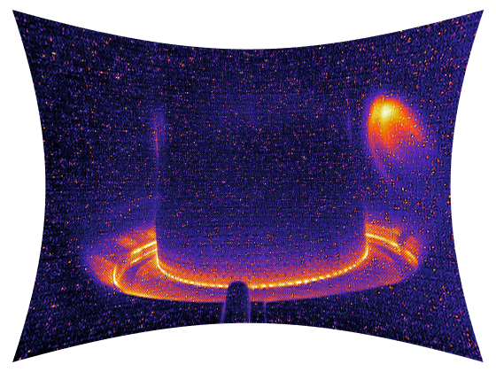
Distortion corrected
Original image
Corrected image

Slide 30
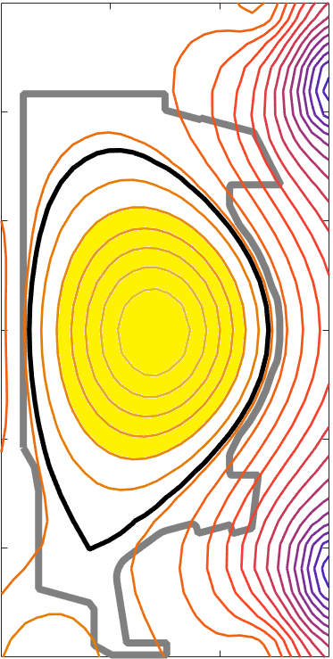
SOFT applied to experiment for the first time
Uniform radial
distribution
SOFT
CODE
+
=
M. Hoppe, et al. Synthetic synchrotron diagnostic for runaway electrons in tokamaks. In progress.
M. Landreman, et al. CPC (2014) A. Stahl, et al. NF (2016)

Slide 31
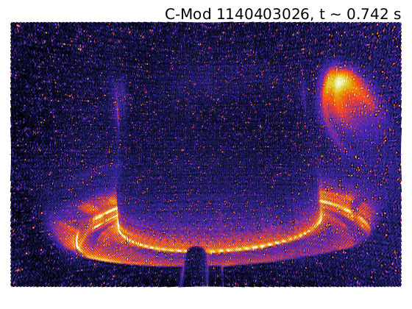
Good agreement between experiment and SOFT
M. Hoppe, et al. Synthetic synchrotron diagnostic for runaway electrons in tokamaks. In progress.
M. Landreman, et al. CPC (2014) A. Stahl, et al. NF (2016)

Slide 32
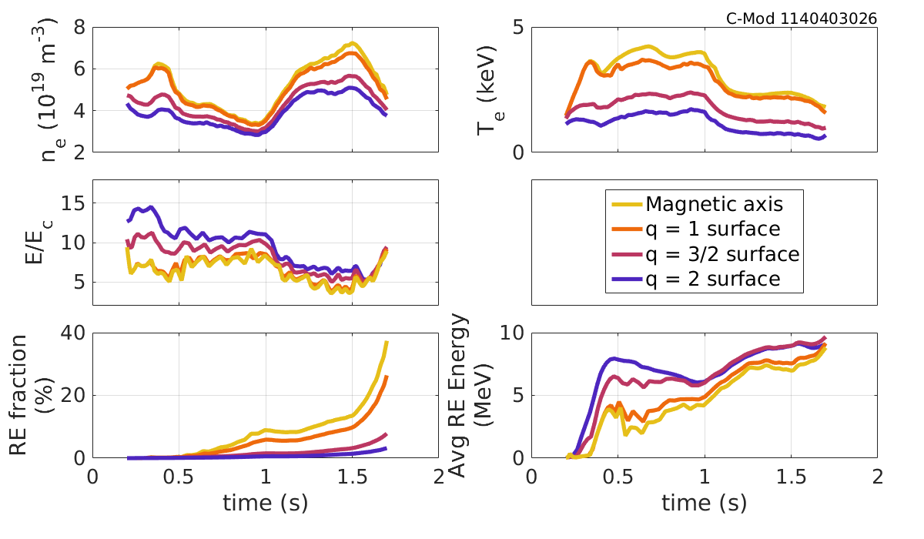
RE energy evolution will also vary in space
Consider rational surfaces – there exists a trade-off in RE energy and density

Slide 33
Summary, part 2
New synthetic camera diagnostic SOFT (with inputs from momentum space solver CODE) shows promise in reproducing experimental synchrotron images
However, the apparent lack of a unique solution makes it difficult to solve the inverse problem and requires us to solve the forward problem (simulations)
Momentum and real space evolutions of REs are coupled as plasma parameters vary in space, so a coupled solver will likely be needed

Slide 34
Outline
Runaway electron synchrotron spectra measured at three magnetic fields
Visible camera images of synchrotron emission and comparison with SOFT
Radial profiles of synchrotron radiation polarization
Questions

Slide 35
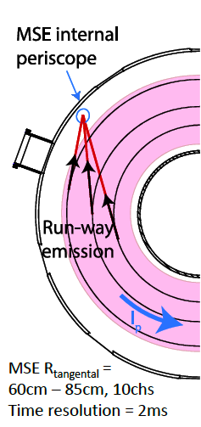
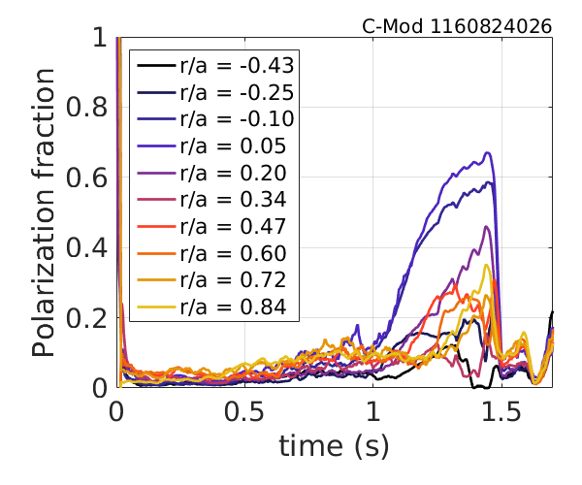
MSE measures polarization at 10 midplane locations

Slide 36
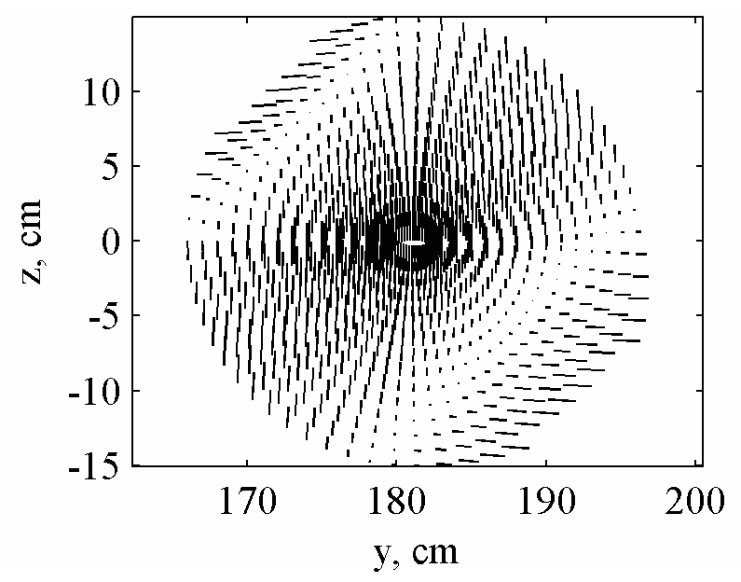
Radial polarization data similar to theory
Synchrotron polarization (poloidal projection).
B₀ = 3 T, R₀ = 1.75 m, a = 0.4 m, q₀ = 1,
r_{b} = 0.15 m, $γ$ = 50, θ = 0.1
Ya.M. Sobolev, ISSN 1562-6016, BAHT (2013)

Slide 37
Radial polarization data similar to theory
Synchrotron polarization (poloidal projection).
B₀ = 3 T, R₀ = 1.75 m, a = 0.4 m, q₀ = 1,
r_{b} = 0.15 m, $γ$ = 50, θ = 0.1
Ya.M. Sobolev, ISSN 1562-6016, BAHT (2013)

Slide 38
Radial polarization data similar to theory
Synchrotron polarization (poloidal projection).
B₀ = 3 T, R₀ = 1.75 m, a = 0.4 m, q₀ = 1,
r_{b} = 0.15 m, $γ$ = 50, θ = 0.1
Ya.M. Sobolev, ISSN 1562-6016, BAHT (2013)

Slide 39
Radial polarization data similar to theory
Synchrotron polarization (poloidal projection).
B₀ = 3 T, R₀ = 1.75 m, a = 0.4 m, q₀ = 1,
r_{b} = 0.15 m, $γ$ = 50, θ = 0.1
Ya.M. Sobolev, ISSN 1562-6016, BAHT (2013)

Slide 40
Radial polarization data similar to theory
Synchrotron polarization (poloidal projection).
B₀ = 3 T, R₀ = 1.75 m, a = 0.4 m, q₀ = 1,
r_{b} = 0.15 m, $γ$ = 50, θ = 0.1
80%
Ya.M. Sobolev, ISSN 1562-6016, BAHT (2013)

Slide 41
Outline
Runaway electron synchrotron spectra measured at three magnetic fields
Visible camera images of synchrotron emission and comparison with SOFT
Radial profiles of synchrotron radiation polarization
Questions

Slide 42
Questions
Three B-fields: The single-particle picture is obviously unphysical. What is the best way to move forward with this analysis? Simulations (thus far) have been semi-successful.

Slide 43
Questions
Three B-fields: The single-particle picture is obviously unphysical. What is the best way to move forward with this analysis? Simulations (thus far) have been semi-successful.
SOFT images: Are flux-surface-averaged quantities good enough? Should we move on to coupled solvers like LUKE?

Slide 44
Questions
Three B-fields: The single-particle picture is obviously unphysical. What is the best way to move forward with this analysis? Simulations (thus far) have been semi-successful.
SOFT images: Are flux-surface-averaged quantities good enough? Should we move on to coupled solvers like LUKE?
Polarization data: Do any codes currently calculate synchrotron polarization? If not, would this be easy to implement?

Slide 45
Extra

Slide 46
Abstract
Alcator C-Mod's high magnetic field allows runaway electron synchrotron emission to be observed in the visible wavelength range. Visible spectrometers were used to measure synchrotron spectra at three magnetic fields: 2.7, 5.4, and 7.8 T. Assuming fixed energy and pitch, the spectral shape is expected to shift toward shorter wavelengths with increasing magnetic field. However, the similarities among measured spectra indicate that runaway electron energies decrease with increased field and are thus limited by synchrotron radiation. Additionally, distortion-corrected visible camera images show the spatial distribution and evolution of runaways in C-Mod. Initial results show good agreement between experiment and the new synthetic diagnostic SOFT (Synchrotron-detecting Orbit-Following Toolkit) [1].
[1] M. Hoppe, et al. Synthetic synchrotron diagnostic for runaway electrons in tokamaks. In progress.

Slide 47
7.8 T
5.4 T
2.7 T
1160824024 1160824026 1160902016

Slide 48
Decreasing RE energy decreases amplitude, shifts toward red
B = 5.4 T, pitch = 0.1
[3]
To keep the brightness the same, an increase in magnetic field
requires a decrease in energy.
I.M. Pankratov. Plasma Phys. Reports 25, 2 (1999).

Slide 49
Evolving RE energy distribution is observed in spectra
Quiescent RE flattop
1160824026
1160824026

Slide 50
Runaway electrons – unique plasma phenomena
In a plasma, the Coulomb collision frequency varies as density/velocity³
$$\frac{dp}{dt}=−eE −F_{c}\left(\frac{n}{v^{2}}\right)$$
There exists a critical electric field [4],
$$E_{c}≈0.08 n_{20}$$
such that for $E≥E_{c}$, some electrons will be continuously accelerated
If $E≥E_{D}=2E_{c}\frac{c^{2}}{v_{th}^{2}}$ [5], all electrons will runaway to relativistic speeds
Collisions between high energy and thermal electrons causes an avalanche of runaway particles
However, accelerating charges radiate:
Magnetic fields → Cyclotron
Collisions → Bremsstrahlung
$$\frac{dp}{dt}=−eE −F_{c} −F_{rad}(\vec{p},B,Z_{eff},…)$$
→ Radiation serves as both a power loss mechanism and useful diagnostic tool

Slide 51
Motivation: Runaway electrons may severely damage ITER
Relativistic “Runaway” Electrons (REs):
Energies $>$ 10 MeV
Current $≤$ 60% of I_{P} [6]
In ITER, RE beams of 9 MA!
REs can cause significant damage to plasma-facing components
It is necessary to understand both the momentum and real space distribution and time evolution to effectively avoid and mitigate REs
RE beam collides with limiter
C-Mod 1160824028

Slide 52
SOFT, Synchrotron-detecting Orbit-Following Toolkit [1]
Synthetic diagnostic simulating a camera inside a tokamak
REs emit highly forward-peaked cone of synchrotron radiation in their direction of motion
SOFT captures light hitting the detector
Lots of flexibility:
Camera viewing geometry (position, angle, aperture size, etc.)
Camera sensitivity (wavelength range)
Magnetic field geometry
Momentum space distributions (energy and pitch) – can also couple to CODE [2,3]
Spatial distributions (radial profiles)
$$Δθ=\frac{1}{γ}$$

Slide 53
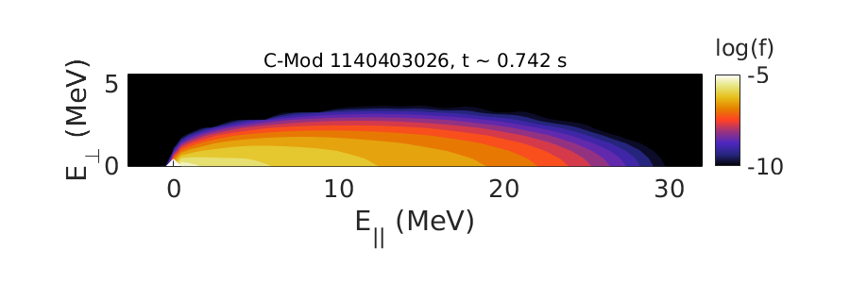
CODE, COllisional Distribution of Electrons [2,3]
Solves the linearized kinetic equation for RE evolution in momentum space
Includes secondary avalanching mechanisms
Plasma parameters vary in time:
Loop voltage → Driving force
Density, temperature, and Z_{eff} → Friction
Magnetic field → Synchrotron power loss

Slide 54
Cameras inside C-Mod capture RE spatial evolution
Due to Alcator C-Mod’s high magnetic field (2-8 T), synchrotron radiation is emitted in the visible wavelength range
Note that ITER ($\sim$5 T) will also have visible synchrotron emission
Cameras are affected by fisheye-lens/barrel distortion
Original (distorted) image
Synchrotron
Emission

Slide 55
In-vessel calibration corrects for camera distortion
Take photos of gridded vacuum vessel cross-section
Map pixel location (radius) to real space position (angle)
Transform to rectilinear image
1
··· Data points
--- Lines of fit
― Rectilinear
2
3
Real space angle from line of sight
Normalized pixel radius

Slide 56
Interesting RE spatial distributions are observed
REs are generated as density (and collisional friction) decreases
Double-parabolic feature forms, grows, and moves in time
(Corrected Image)
Pixel Brightness
t $\sim$ 0.742 s
Left
Right

Slide 57
Good agreement between SOFT and experiment
Uses uniform spatial/radial profile (shaded)
Produces very similar parabolic structure
Does not yet capture double feature
Magnetic
Geometry
CODE
SOFT
+
←

Slide 58
Good agreement between SOFT and experiment
SOFT

Slide 59
Good agreement between experiment and SOFT
SOFT

Slide 60
Entry video

Slide 62
Summary, part 2
Visible images of synchrotron emission can provide useful information of the spatial distribution and evolution of REs
New synthetic camera diagnostic SOFT (with inputs from momentum space solver CODE) shows promise in reproducing experimental synchrotron images
However, the apparent lack of a unique solution makes it difficult to solve the inverse problem and requires us to solve the forward problem (simulations)
Momentum and real space evolutions of REs are coupled as plasma parameters vary in space, so a coupled solver will likely be needed
Future work will utilize SOFT’s capability to include varying spatial profiles of different RE energy distributions

