Slide 1







Post-disruptive RE beams in COMPASS and related diagnostics
O Ficker, J Mlynář, M Vlainic, E Macúšová, V Weinzettl, J Urban, J Čeřovský, R Papřok, M Farník, V Plyusnin, E Mateeva, J Havlíček, P Vondráček, T Markovič, J Varju, M Gospodarczyk, M Jakubowski, M Rabinski, J Zebrowski, R Pánek, M Hron COMPASS & MST1 teams
Institute of Plasma Physics of the CAS, Prague, Czech Republic
Faculty of nuclear sciences and physical Engineering, CTU, Prague, Czech Republic
Faculty of Mathematics and Physics, Charles University, Prague, Czech Republic
National Centre for nuclear research, Świerk, Poland
Instituto de Plasmas e Fusão Nuclear, Lisbon, Portugal
Notes:
100 m vysoko, metru za sekundu.

Slide 2

OUTLINE
This talk: special diagnostics and MGI generated RE beams
Second talk: Runaway electron studies during the flattop phase in COMPASS (Eva)
Outline of this talk
  Overview of the Vertical ECE & Cherenkov detector
  Ramp-up MGI triggered RE beams scenario
    Filaments?
  Slow gas puff triggered ‘beams’
  Ar penetration to the beam and beam decay
  Outlook for experiments (next two weeks) and analysis
  A bit of JET SXR tomography
Notes:
100 m vysoko, metru za sekundu.

Slide 3
STATISTICS, TEAM and PUBLICATIONS
Changes in the team:
  Miloš Vlainič left (finishing his PhD this year)
  Eva Macúšová started in August 2016 as a post-doc (modelling and experiments)
  Andrea Casolari started in March 2017 as a post-doc (MHD-RE modelling)
Master Students:
  Jaroslav Čeřovský – continues, now focused on Cherenkov detector data
  Michal Farník - moved from general ECE data interpretation to RE related ECE data
  Sundaresan Sridhar – EM fusion master student, focused on magnetic islands and RE
First campaign in June 2016, 10 sessions, 114 good discharges, focused on post-disruption RE beam (Ar puff), RE losses due to MHD active plasmas.
Second campaign December 2016, 101 good discharges focused on development of MARTe control of the RE beam
Notes:
100 m vysoko, metru za sekundu.

Slide 4
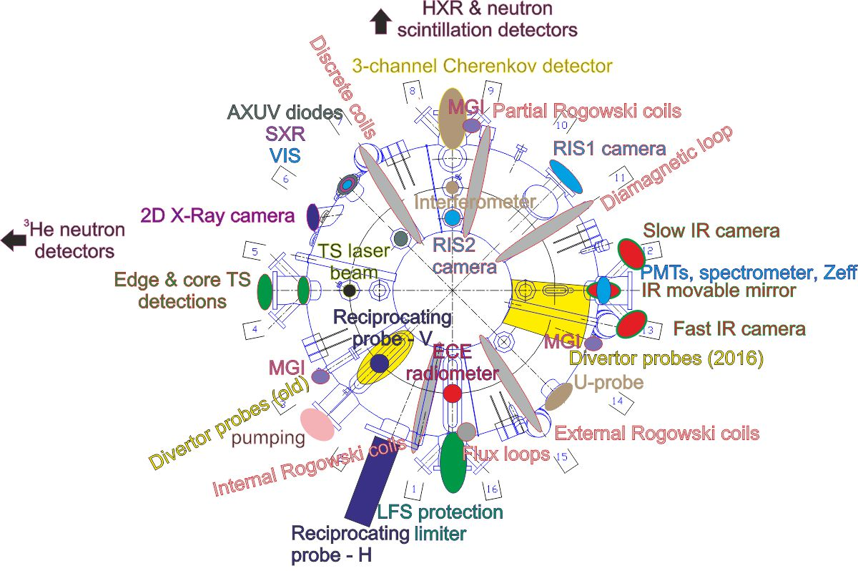
Diagnostics set-up – last RE campaign
Notes:
100 m vysoko, metru za sekundu.

Slide 5
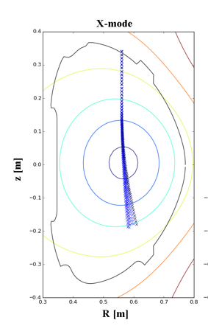
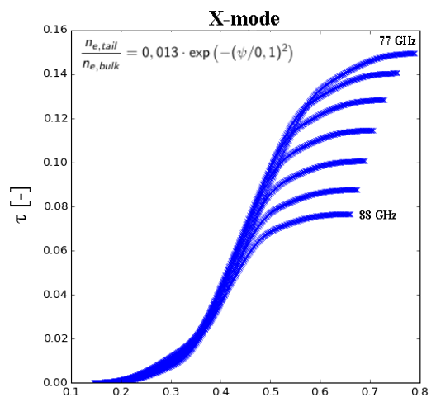
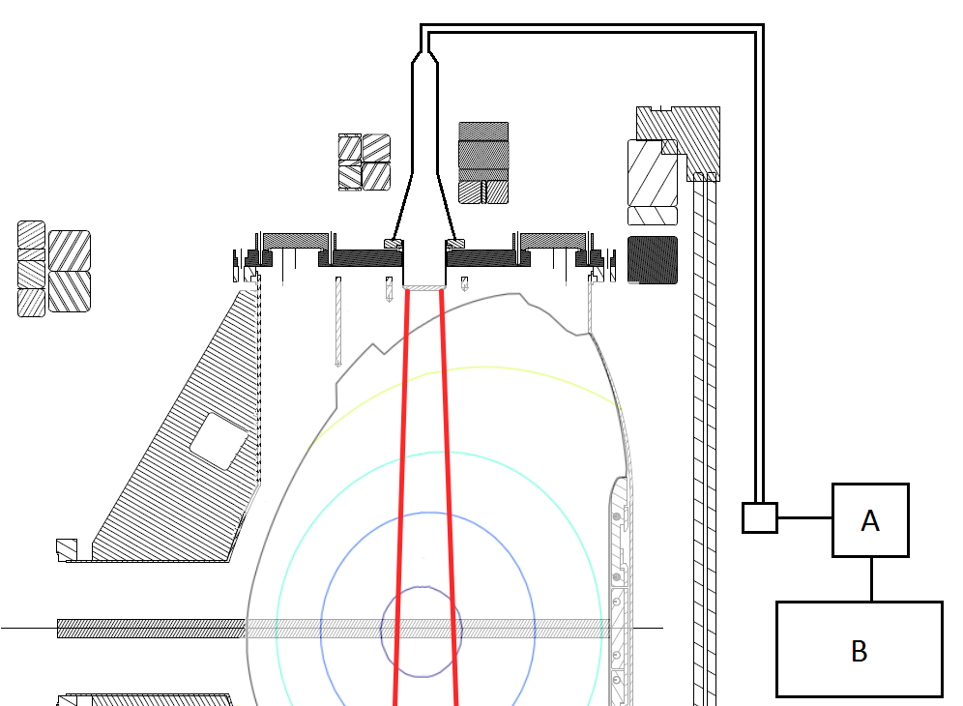
Vertical ECE – optical depth
Measurement of the third harmonic and higher
Line of sight along constant B ⇒ resonance dominated by E (v_{per},v_{par})
Analysis in optically thin plasmas difficult
X mode is of interest
Path length [m]
Notes:
100 m vysoko, metru za sekundu.

Slide 6
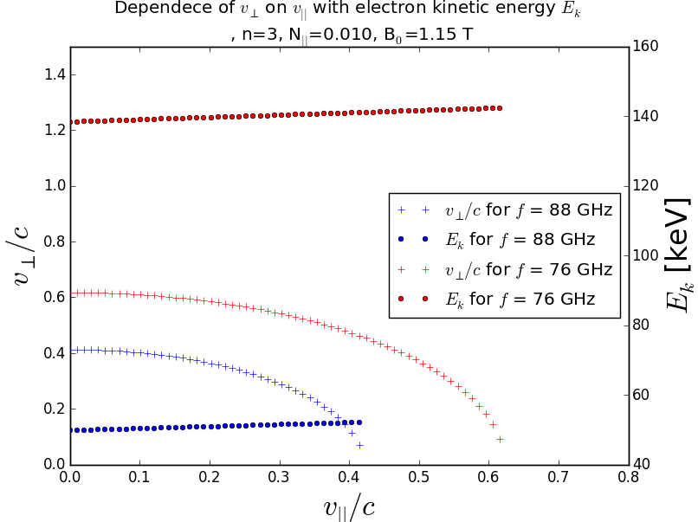
Vertical ECE – measurable energies
Notes:
100 m vysoko, metru za sekundu.

Slide 7
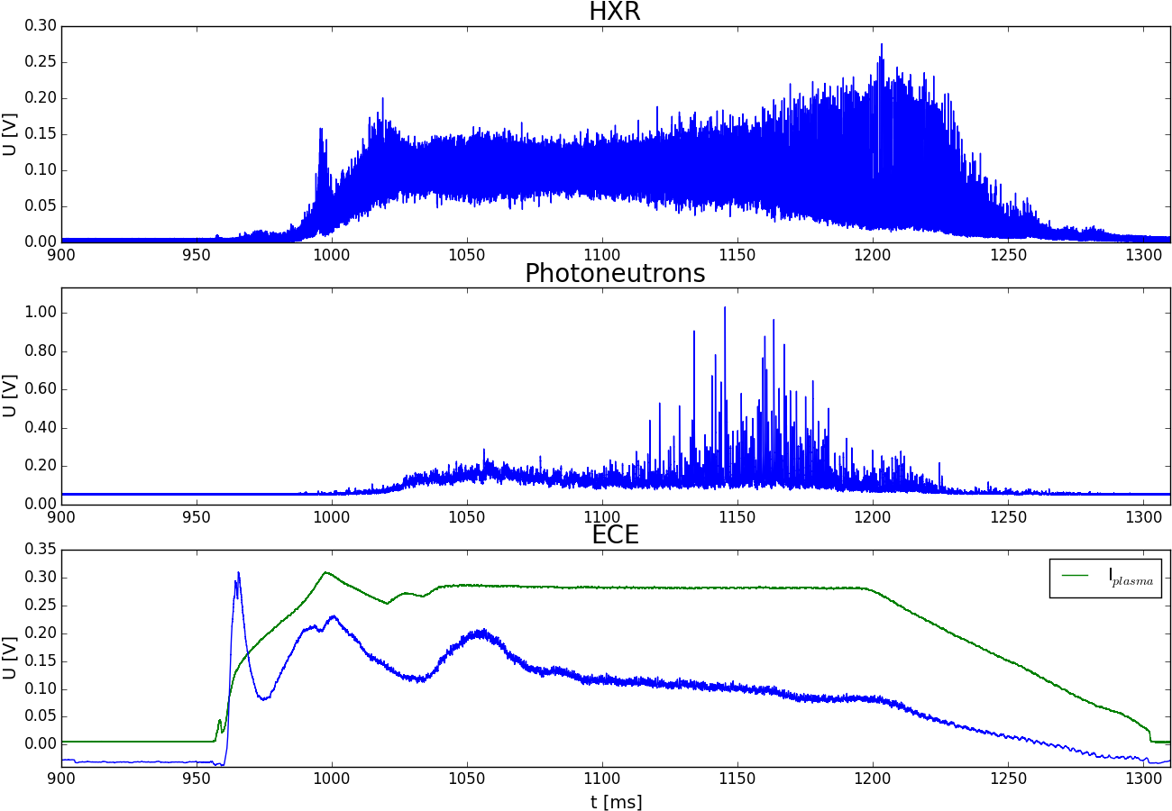
Vertical ECE – flattop example
Notes:
100 m vysoko, metru za sekundu.

Slide 8
Cherenkov Detector
<58 keV
<145 keV
<211 keV
Direct detection of lost RE
Diamond of the CVD type, Mo layer for E_{thr}
3 channels: E_{thr}<58, <145, <211 keV
Outer midplane in front of the protection limiter
Notes:
100 m vysoko, metru za sekundu.

Slide 9
Scenarios to achieve RE beam
MGI in current ramp-up
  Ip in range 50 to 100 kA, early after the breakdown 10-25 ms
  Prescribed high E field, standard B=1.15T (!)
  MGI 1.4-3.0 bar of Ar, number of particles injected 2-6e20 m⁻³
  TQ, CQ, RE plateaus of current 0-75% of the pre-disruptive, up to 25 ms,
  “steady” decrease of current or position instability (radial/vertical)
Long low density discharge
  Up to 1.3 s (standard COMPASS discharge 350 ms) - loop voltage negligible
  No fueling after breakdown, density drops below 0.5e19 m⁻³
  Position relatively stable, thermal component still present
Slow Ar gas puff into low density plasmas
  Starting as previous with a bit more fueling
  Bottom piezovalve injects 1e18-1e19 Ar atoms (~N_{e} before injection) in 15 ms
  T_{e} slowly achieves zero, part of current is lost
  Only RE remain, radial position unstable
Notes:
100 m vysoko, metru za sekundu.

Slide 10
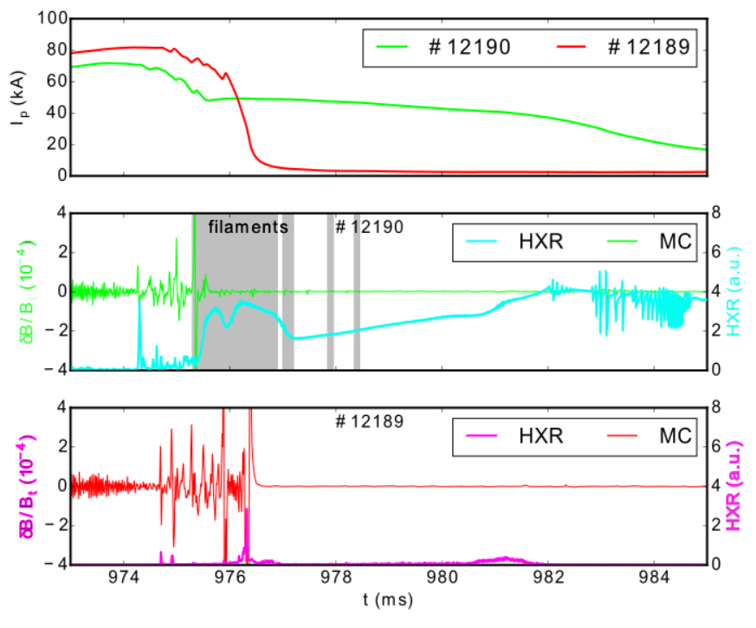
Ar MGI in the ramp-up: Magnetics vs HXR
RE BEAM
NO BEAM
Ficker et al. 2017 Nucl. Fusion 37
Notes:
100 m vysoko, metru za sekundu.

Slide 11
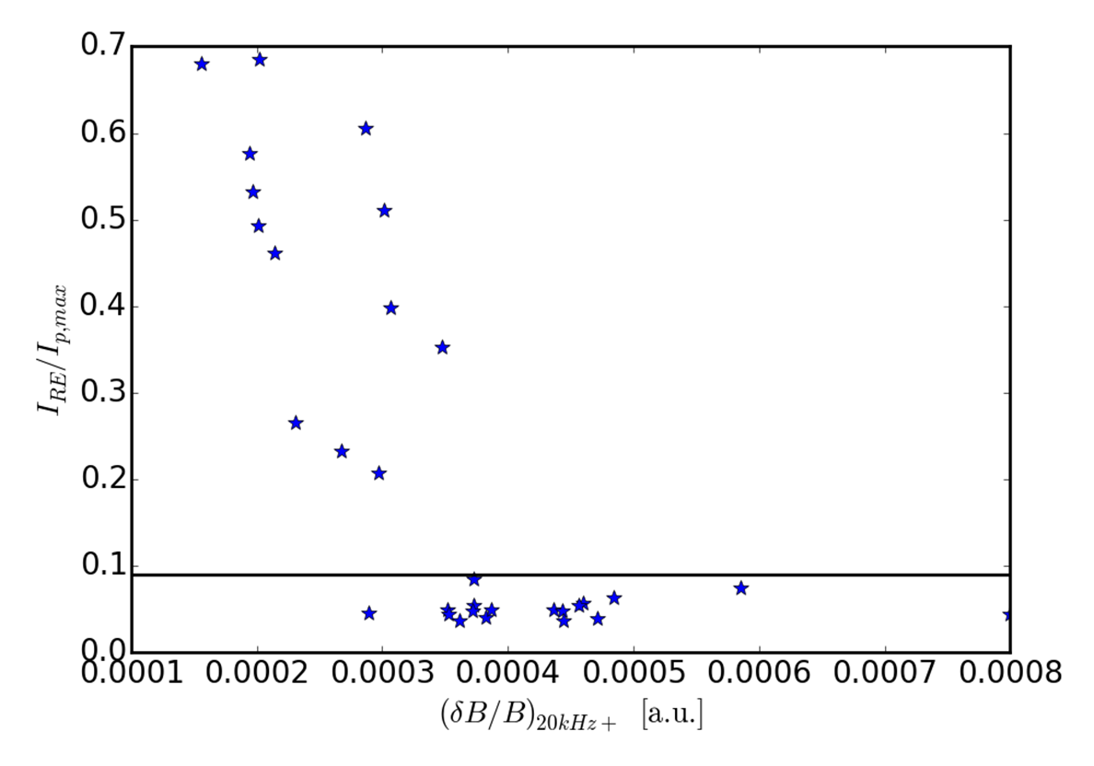
MC oscillations vs runaway current
As (Zeng et al., PRL 2013) for TEXTOR? – not straightforward on COMPASS…
Notes:
100 m vysoko, metru za sekundu.

Slide 12
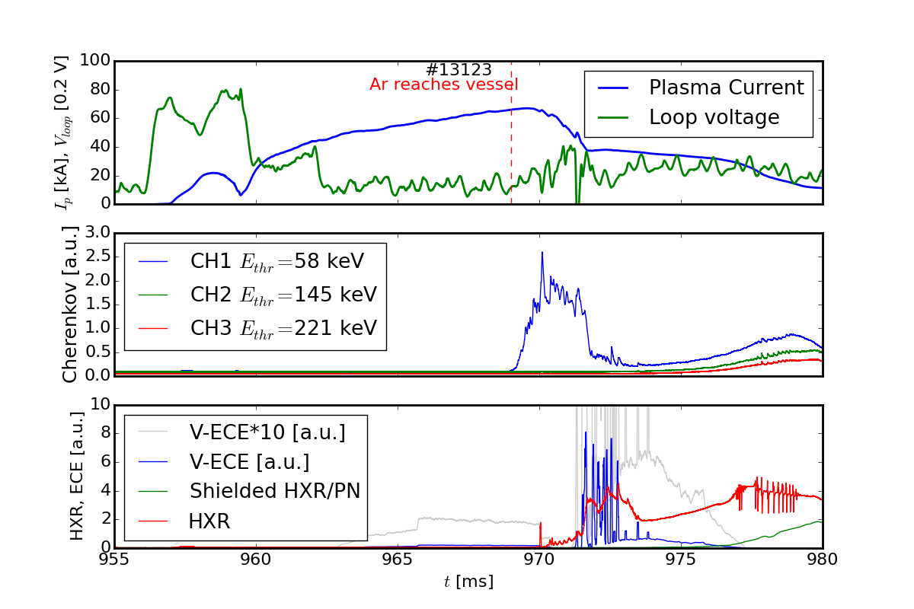
What V-ECE and Cherenkov show?
Particles
Radiation
Notes:
100 m vysoko, metru za sekundu.

Slide 13
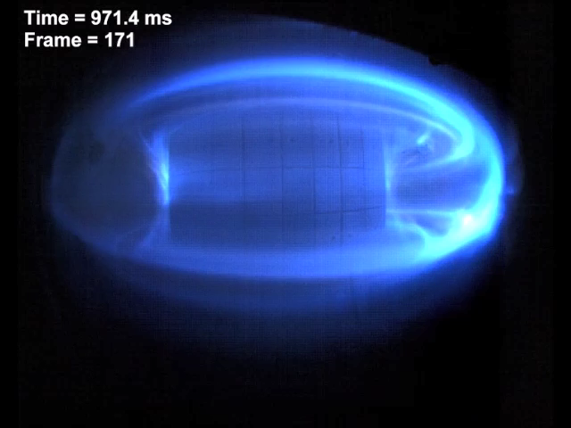
MGI in ramp-up RIS video
Notes:
100 m vysoko, metru za sekundu.

Slide 14
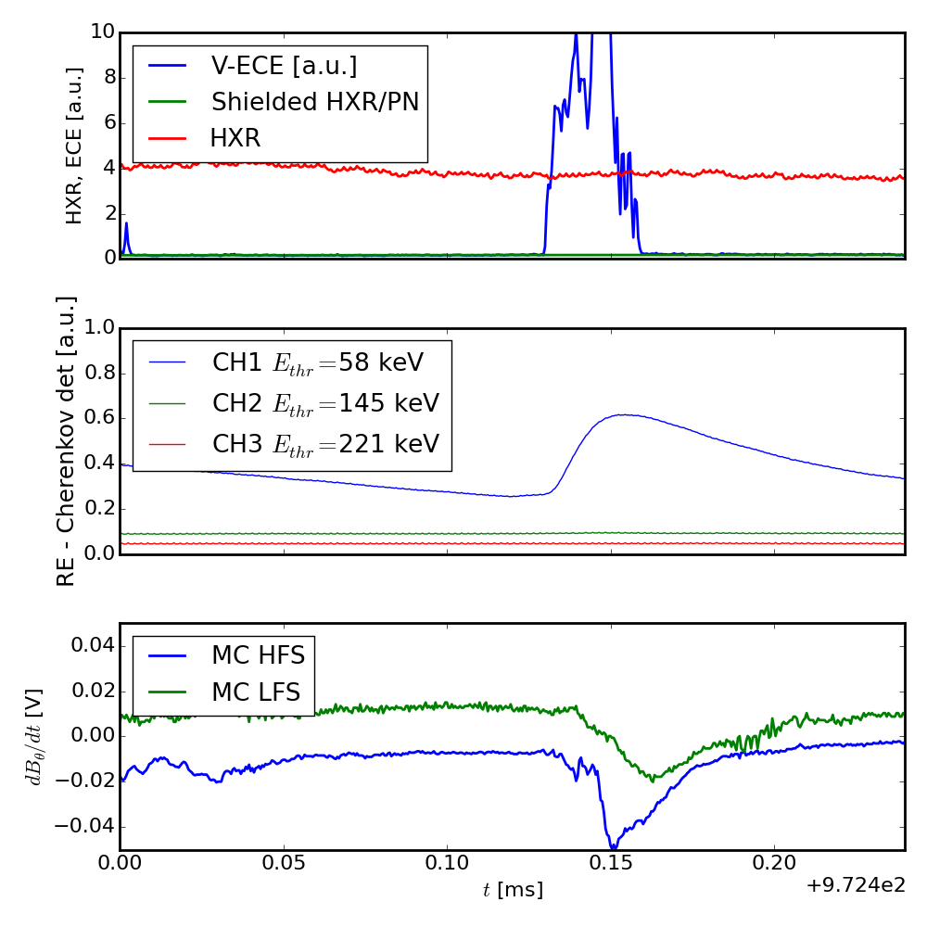
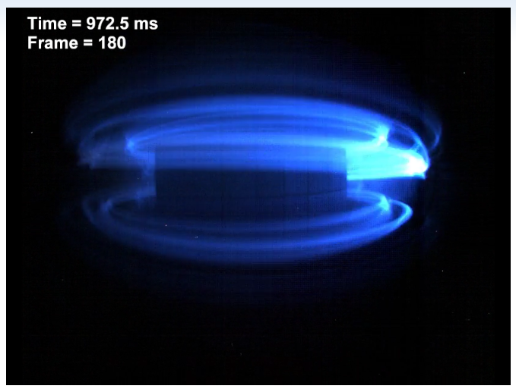
MGI RE: Filaments in detail
ECE, Cherenkov, Magnetics
Visible camera - filaments
  Exposition time vs sampling time
  Sobel filter for detection
Fast electrons or impurities?
ECE spikes last <30 μs
Notes:
100 m vysoko, metru za sekundu.

Slide 15
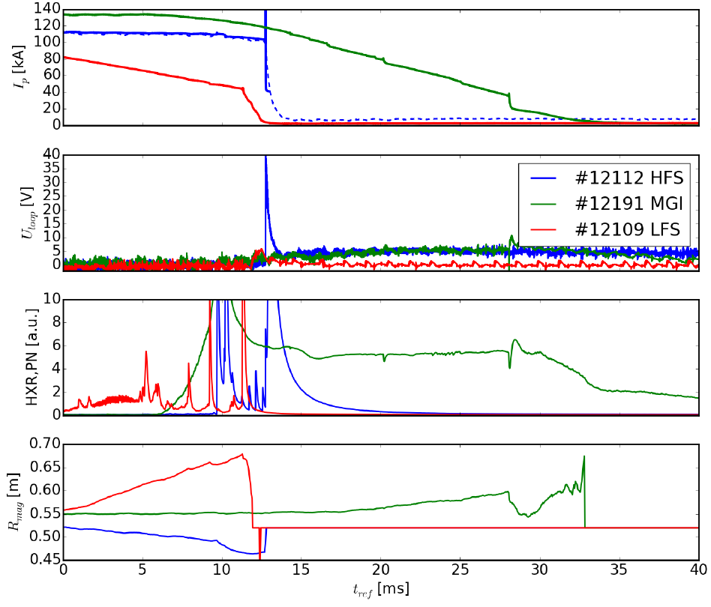
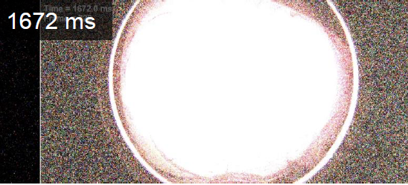
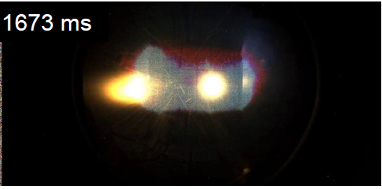
Long discharge - Termination phase
Current ramp-down difficult
HFS termination
dI/dt>10 GA/s !!!
Huge amount of radiation in short time…
Ficker O. et al 2016 58th Ann. Meeting
APS DPP (San Jose,USA)
HFS termination
Notes:
100 m vysoko, metru za sekundu.

Slide 16
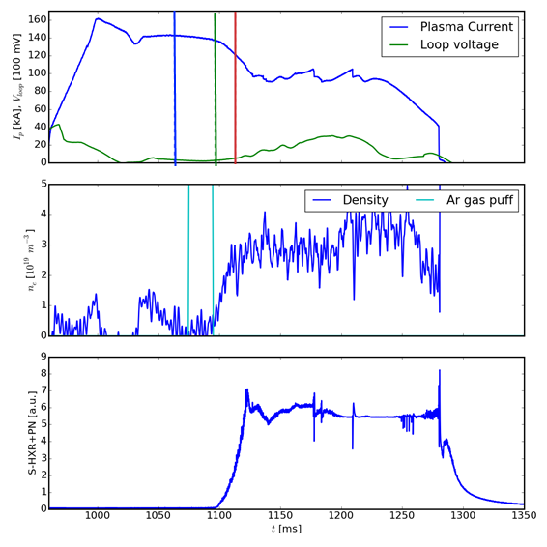
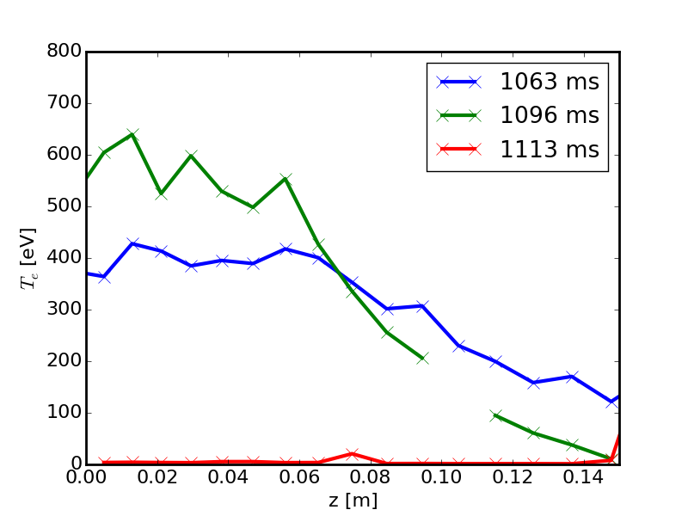
Slow gas-puff scenario
T_{e} times
Very good repeatability
Beam mitigation and heat load experiments suitable
Control issues to be solved
  Loop voltage and position
Comparison with TCV
T_{e}
Notes:
100 m vysoko, metru za sekundu.

Slide 17
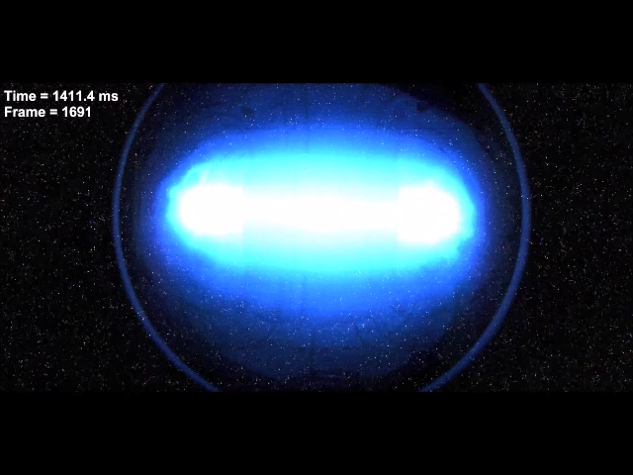
MGI into evolved RE beam – decay phase
Notes:
100 m vysoko, metru za sekundu.

Slide 18
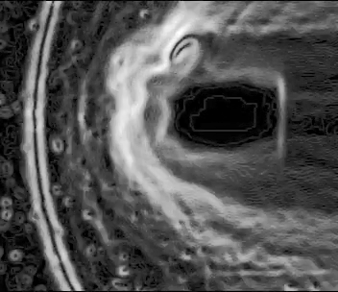
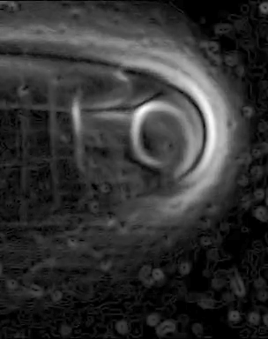
MGI into evolved RE beam –
Edge instability, Ar penetration
#12191
#13166
Notes:
100 m vysoko, metru za sekundu.

Slide 19
Summary and future
V-ECE and Cherenkov detector – useful low energy RE diagnostics
3 scenarios to achieve RE beam with interesting features
  MGI in ramp-up: filaments in early plateau phase
  Long low density discharge: extremely fast HFS termination
  Slow gas puff: slow TQ and CQ
Next week - experiments:
  even faster camera measurements (up to 1MSps)
  RMPs, HFS limiter heat loads with calibrated fast IR camera
Analysis plans
  Current tomography
  Video analysis (movement of filaments, beam edge instability,…)
  ECE – energy resolution using different channels more modelling,. ..
What way should we go? What kind of RE beer should we brew?
Notes:
100 m vysoko, metru za sekundu.

Slide 20
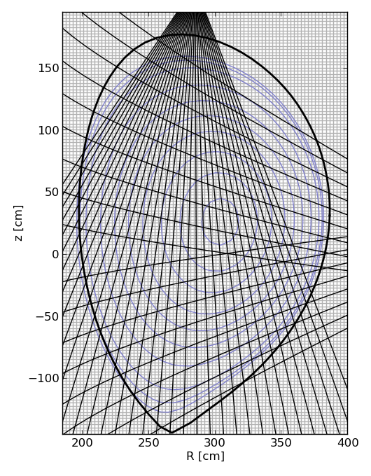
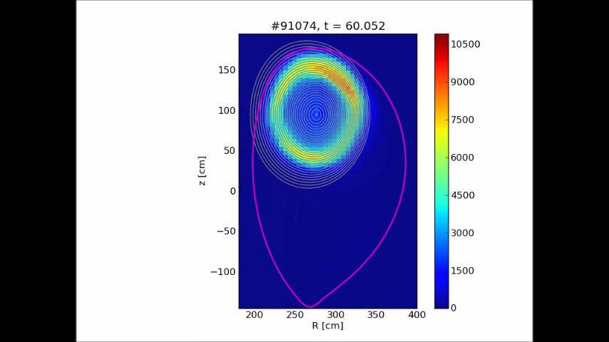
JET – SXR tomography of 2nd DMV
SXR
1-20 keV, braking radiation of electrons, line radiation
RE beam – gas interaction
Tomography
MFR - Tikhonov regularization
2 cameras used
Hollow profile – gas cannot get into the beam??
Notes:
100 m vysoko, metru za sekundu.

Slide 21
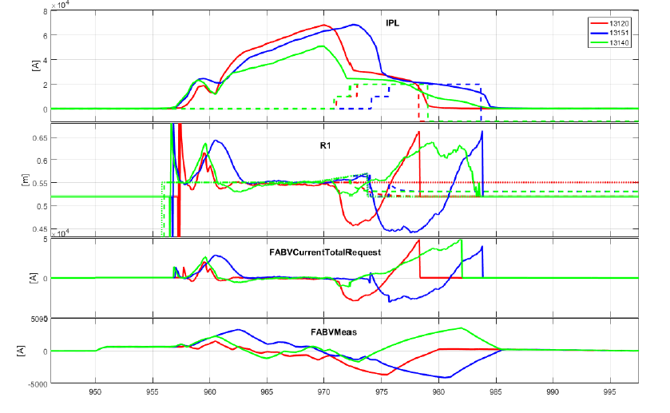
Feedback – M. Gospodarczyk
Notes:
100 m vysoko, metru za sekundu.

Slide 22
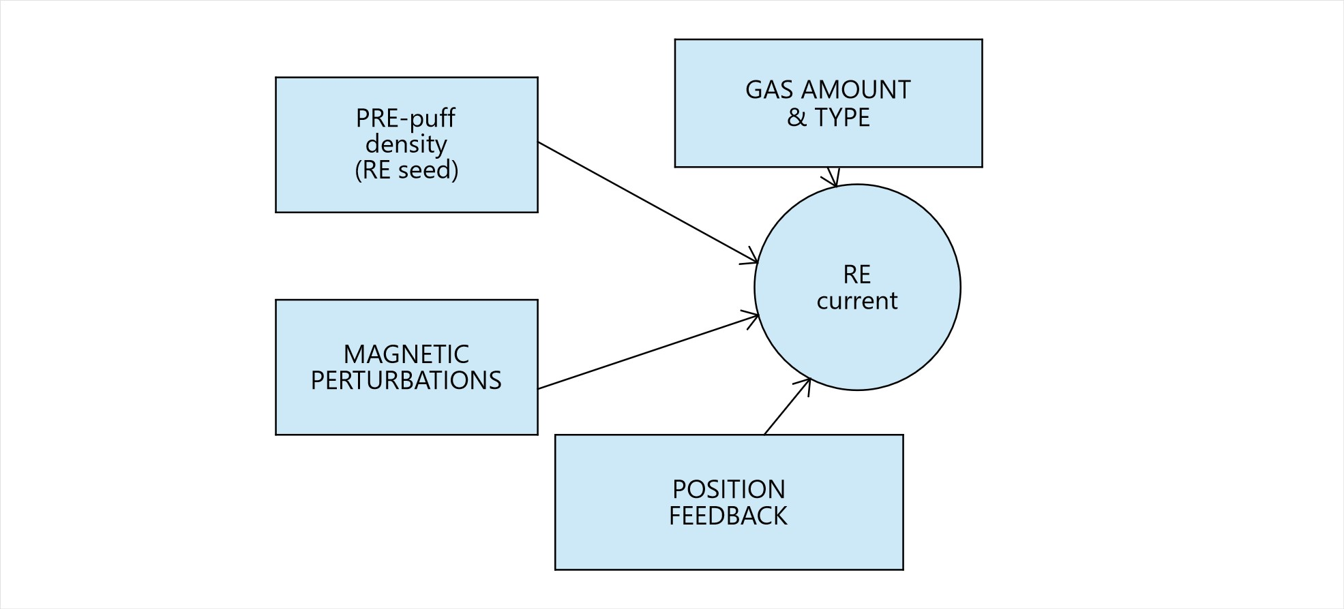
Discussion
What may affect runaway current
after MGI in COMPASS?
Notes:
100 m vysoko, metru za sekundu.

