Slide 1
5th Runaway Electron Meeting (REM-2017)
Overview of
ITER Hard X-Ray Monitor
Santosh P. Pandya^{1,2}, Robin Barnsley², Richard O'Connor²,
Govindarajan Jagannathan², Roger Huxford³ and Michael Walsh²
¹Aix-Marseille Université, Marseille, France
²ITER Organization, Route de Vinon-sur-Verdon, CS 90 046, 13067, St. Paul Lez Durance Cedex, France
³RBH Optics, 26 Park Close, Burgess Hill, West Sussex, RH15 8HL, UK
Disclaimer: The views and opinions expressed herein do not necessarily reflect those of the ITER Organization

Slide 2
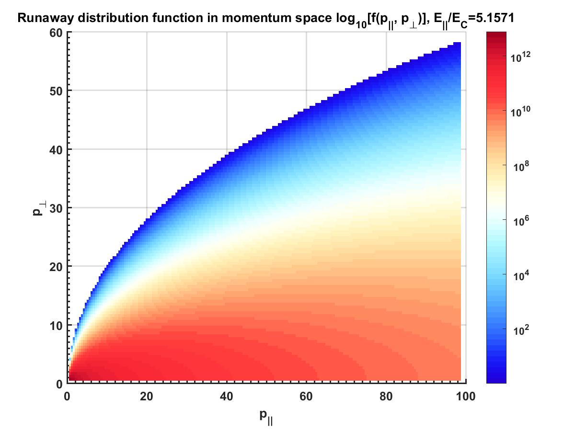
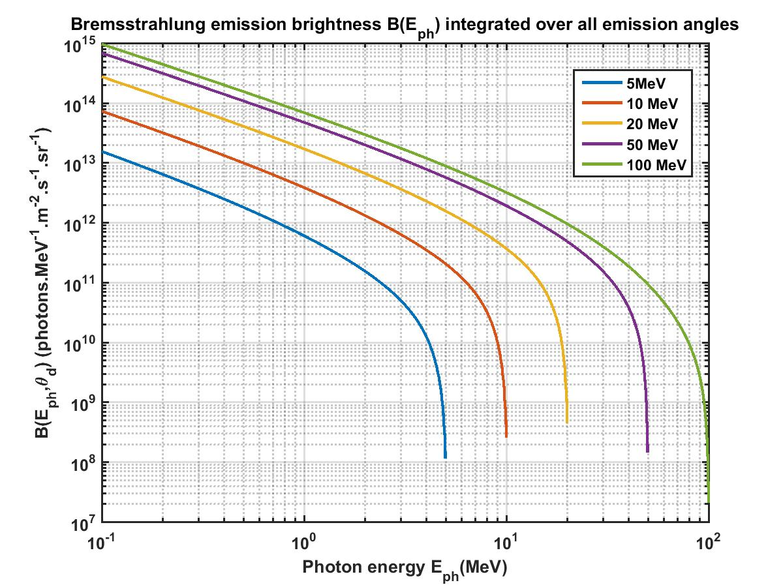
Hard X-Ray Monitor for ITER
Hard X-Ray Monitor is proposed for the first plasma phase in ITER (2007)
The system will detect existence of runaway electrons during plasma discharge by detecting thin-target and thick-target Bremsstrahlung emission
Runaway electron
distribution
Bremsstrahlung
emission

Slide 3
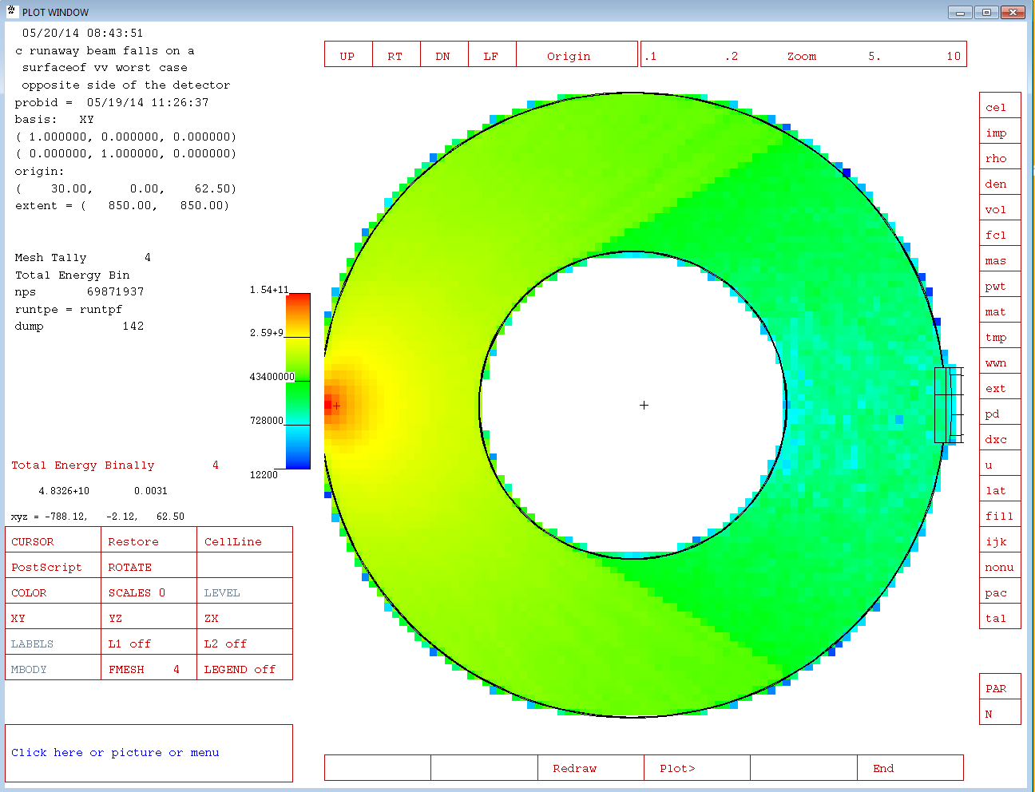
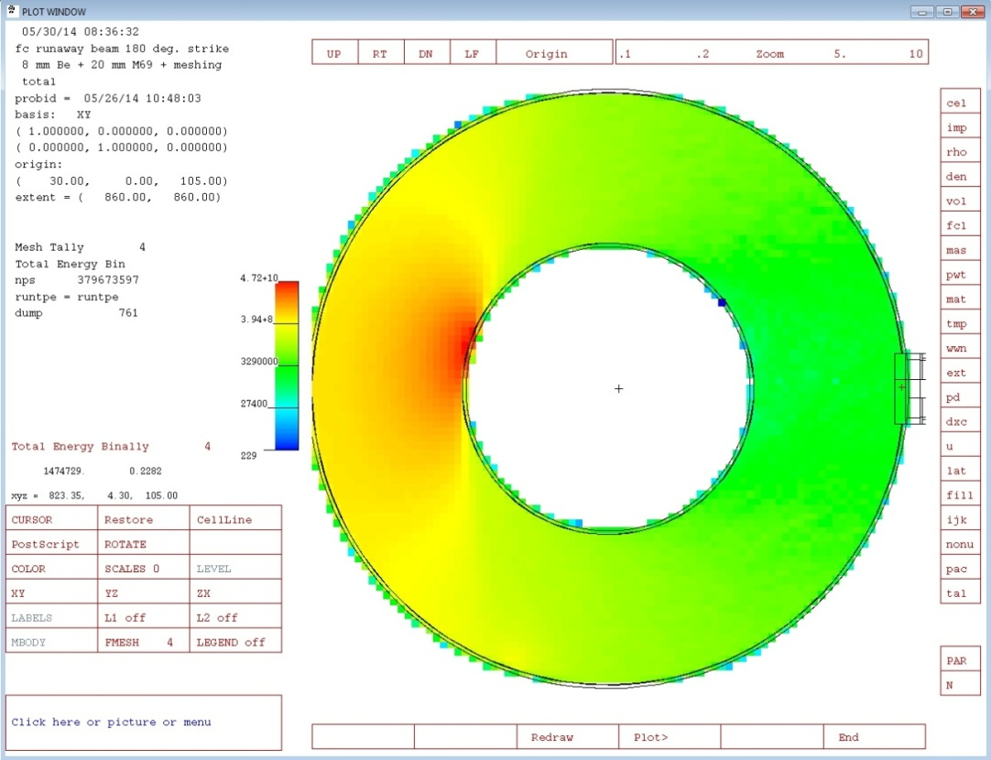
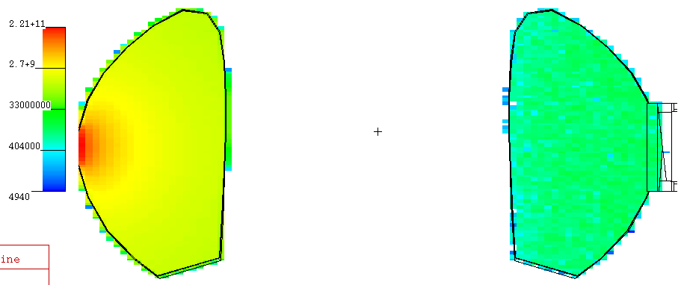
MCNP analysis
RE current striking point
RE current striking point
HXRM
Detector location
Ref.: IDM_UID_NEFNEU
Credit: Rajnikant Makwana
Notes:
3

Slide 4
MCNP analysis
Normalized Flux at HXRM Detector location
Normalized Flux where RE beam is striking
Notes:
4

Slide 5
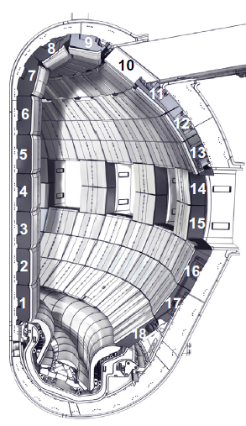
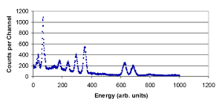
High attenuation of HXRs from FW shielding
HXR-monitor: Relatively a simple diagnostic in other tokamaks
Unlike other tokamaks, ITER has heavy shielding material and attenuates HXR-flux
In case of other tokamaks
Port Plug
HXR-Data

Slide 6
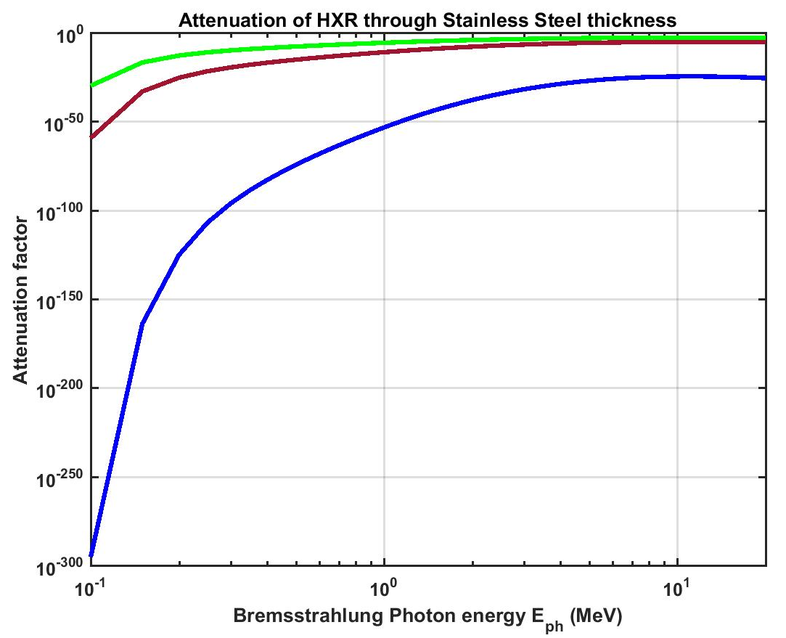
High attenuation of HXRs from FW shielding
Penetration thickness outside Vacuum Vessel (VV): ~600 mm
Diagnostic Port Plug : ~3000 mm
DFW:~255 mm
Location: outside the VV
Port Plug

Slide 7
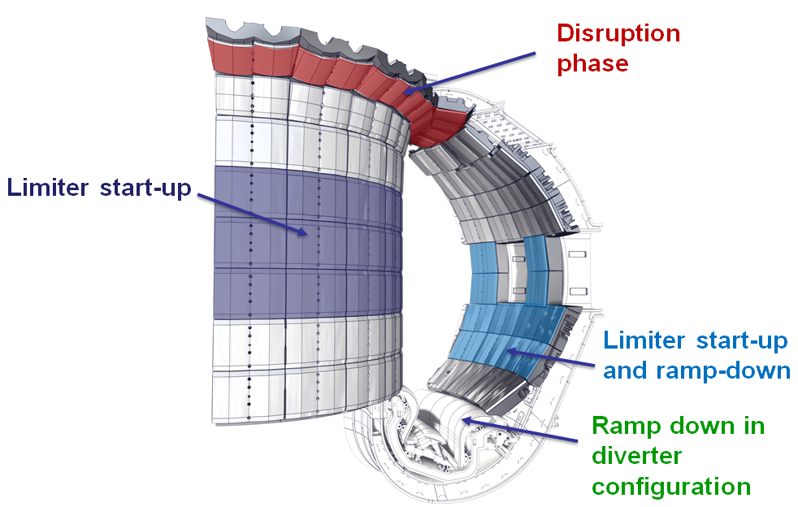
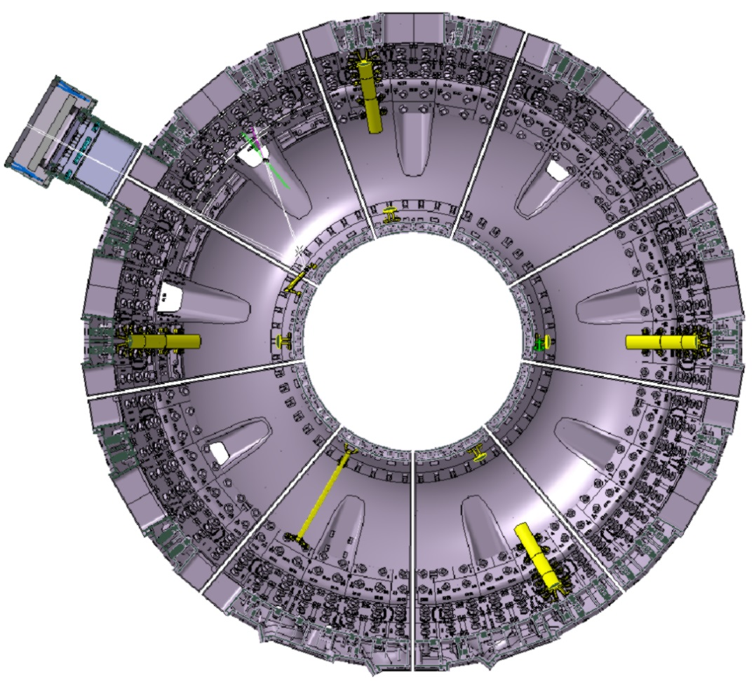
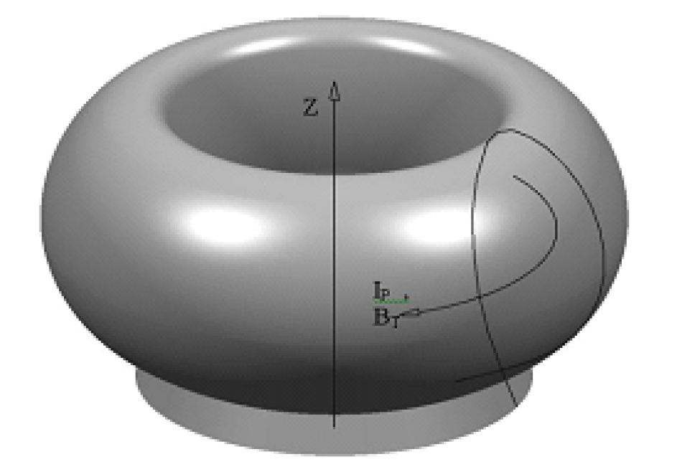
Location of the Hard X-Ray Monitor
Location of
HXR-monitor
(EQP12)
TL7
Sector 6
Anticipated locations
of runaway interaction
TL9
ECRH-mirror
DRS
TL5
I_{RE}
TL3
RE current direction

Slide 8
High attenuation of HXRs from FW shielding
Potential location for HXR-monitor:
Design complications :
High temperature environment
Vacuum environment
Interface problems
Nuclear heating
PMT needs to be de-coupled from the Scintillator
Introduction of optics
Safety important penetrations
Port Plug

Slide 9
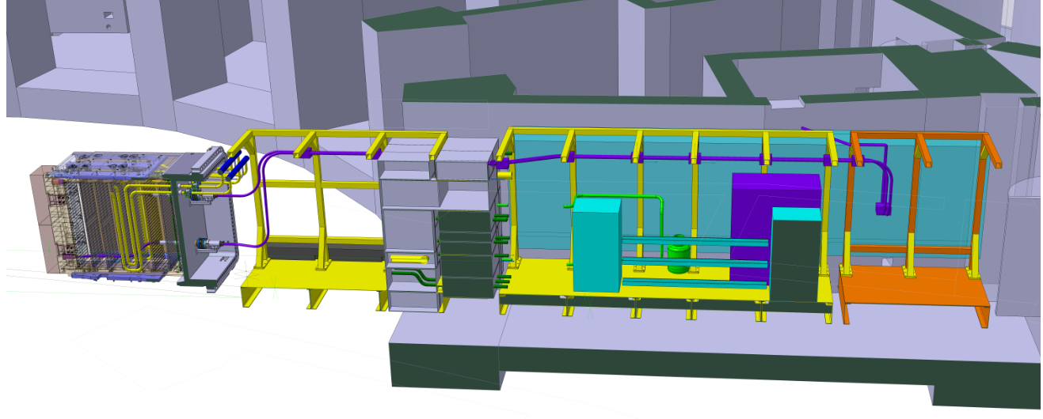
Hard X-Ray system layout
Standard
Optical window
Optical fiber
Bundle in PCSS
Electrical Cables to
interface with DAQ
Optical fiber
Bundle inside
the DSM
Bio-shield
dogleg
PMT-box
Lens
assembly
Optical fiber
Bundle in ISS
Scintillator

Slide 10
Potential Scintillator-crystals for the Hard X-Ray monitor
Properties | Scintillators
 | LaBr₃(Ce) | CeBr₃ | La-GPS | Ce:GAGG | HR-GAGG | Ce:LYSO | BGO | SrI2(Eu)
Light yield (Photons/MeV) | 63000 | 60000 | 30000 – 40000 | 56000 - 57000 | 40000 - 50000 | 34000 | 8000 | 70000 – 80000
Decay time (ns) | 16 | 19 | 50 – 70 | 88(91%) 258(9%) | 138ns(71%) 649ns(29%) | 40 | 300 | 300 – 1500
Density (g/cm³) | 5.08 | 5.10 | 5.3 | 6.63 | 6.3 | 7.1 | 7.13 | 4.6
Peak emission (nm) | 380 | 380 | 390-410 | 520 | 520 | 420 | 480 | 420
Energy resolution (% @662keV) | 2.9 | 3.8 | 5-6 | 5.2 | ~4 | 10 | 12 | 3 – 4
Hygroscopic | Yes | Yes | No | No | No | No | No | Yes
Melting point (⁰C) | 783 | 722 | 1750 | 1850 | 1850 | 2150 | - | -
Boiling point (⁰C) | 1577 | 1457 | - | - | - | - | - | -
2nd Option
Potential scintillator (1nd option):
Operational temperature: up to 175⁰C
Experimentally tested up to 200⁰C with heating / cooling rate 2.25 ⁰C/min
La-GPS=Ce:(La,Gd)₂Si₂O₇
Ce:GAGG=Ce:Gd₃Al₂Ga₃O₁₂
HR-GAGG=Ce:Gd₃(GaAl)₅O₁₂
BGO=Bi₄Ge₃O₁₂

Slide 11
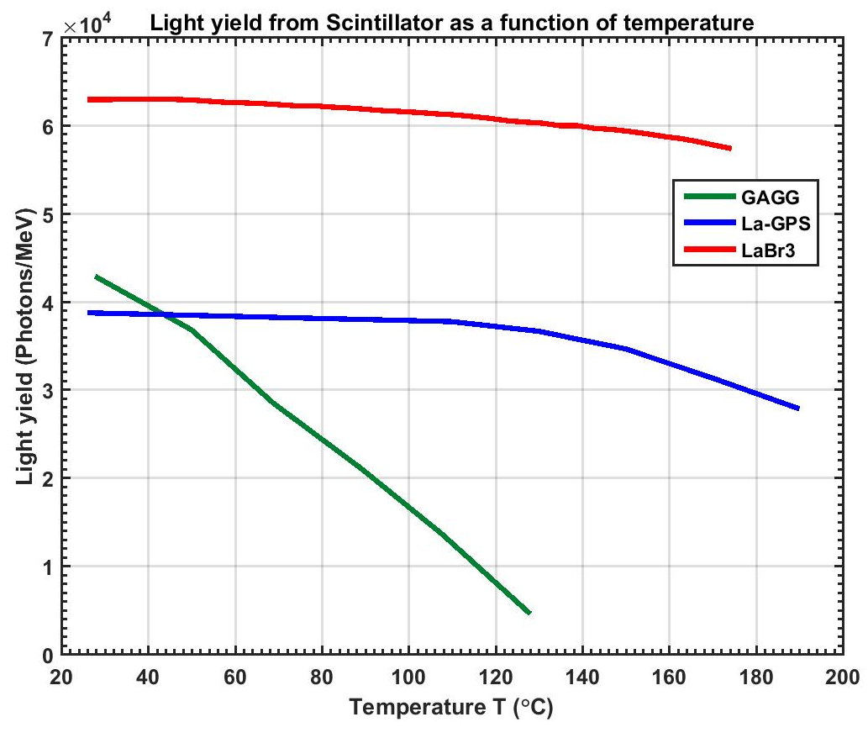
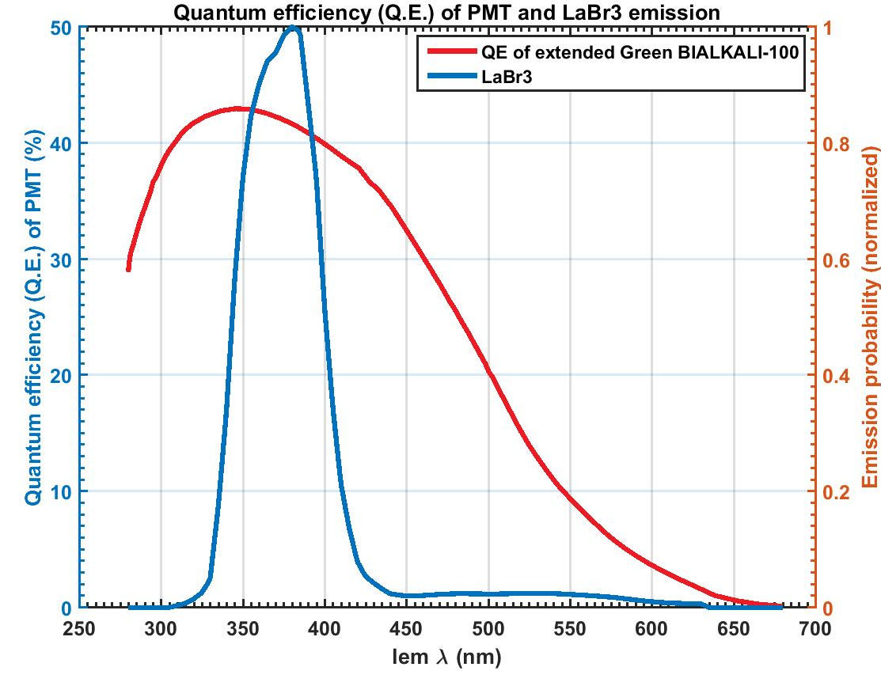
Light outputs from Scintillator (LaBr3 and La-GPS)
Operational
regime

Slide 12
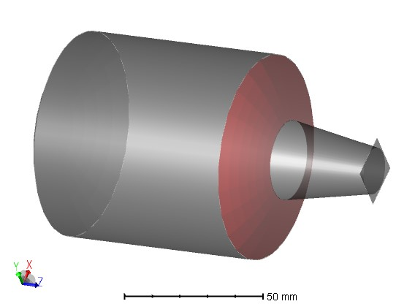
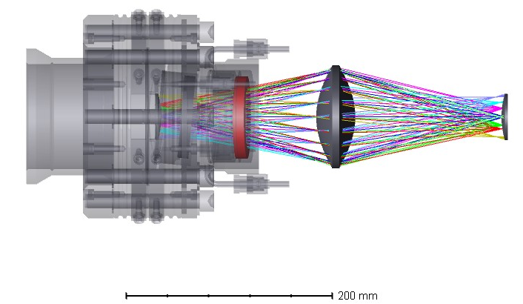
Optical design analysis
Non-imaging collection optics having overall transmission efficiency >0.5%
Collection and
transmission efficiency~95%
Scintillator
Optical
Fiber
bundle
Optical
Fiber
bundle
Connector
Port-cell area

Slide 13
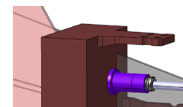
Lowest detectable energy (in MeV) from the instrument
LaBr3(Ce)
Single
HXR-photon
Noise level
Optical fiber
Coupling to PMT
≥60 keV, Energy detection
threshold for single
HXR-photon
Direct
Coupling to PMT

Slide 14
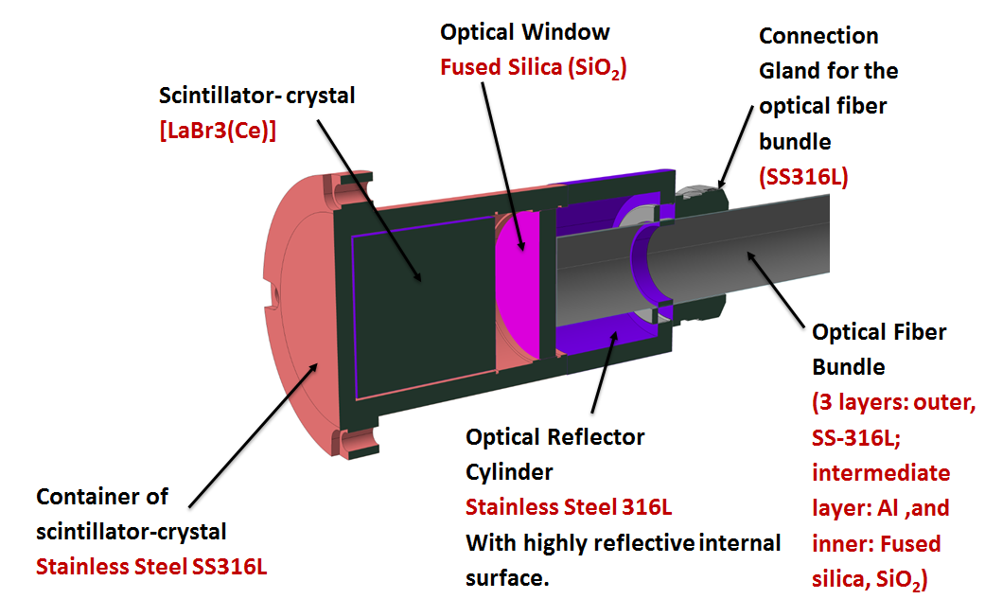
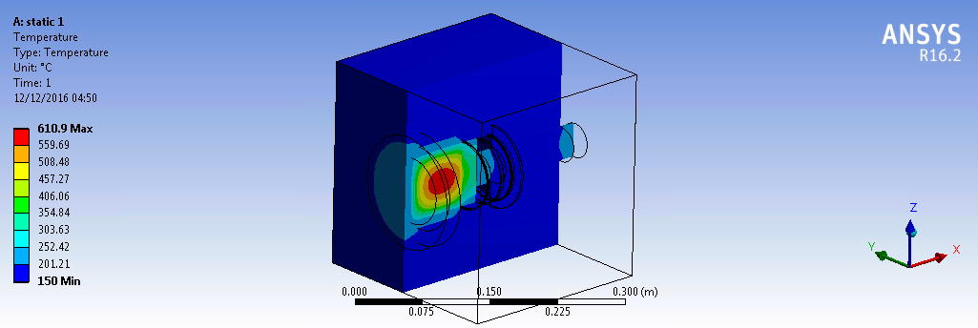
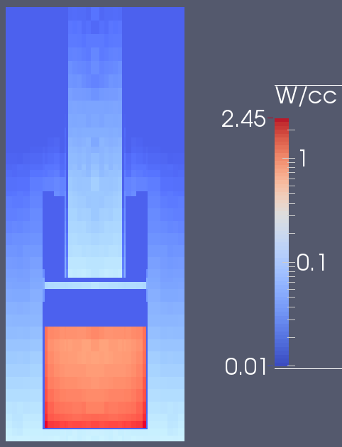
Detector size optimization for the nuclear heating
Credit: Raquel García, Juan-Pablo Catalan and Luciano Bertalot for Neutronic analysis
Credit: Julio for helping in FEM simulation

Slide 15
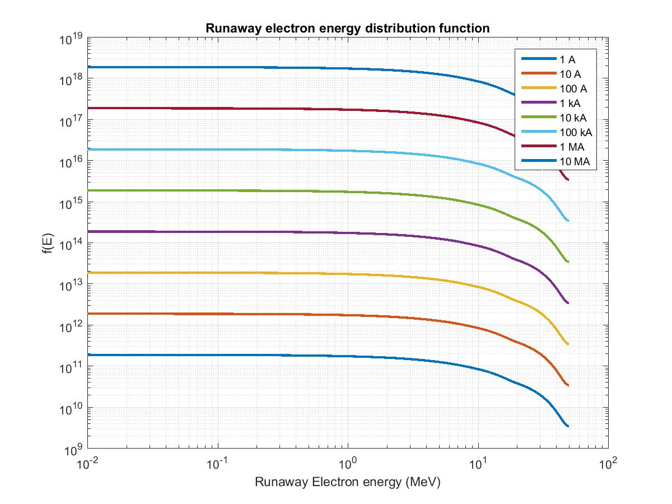
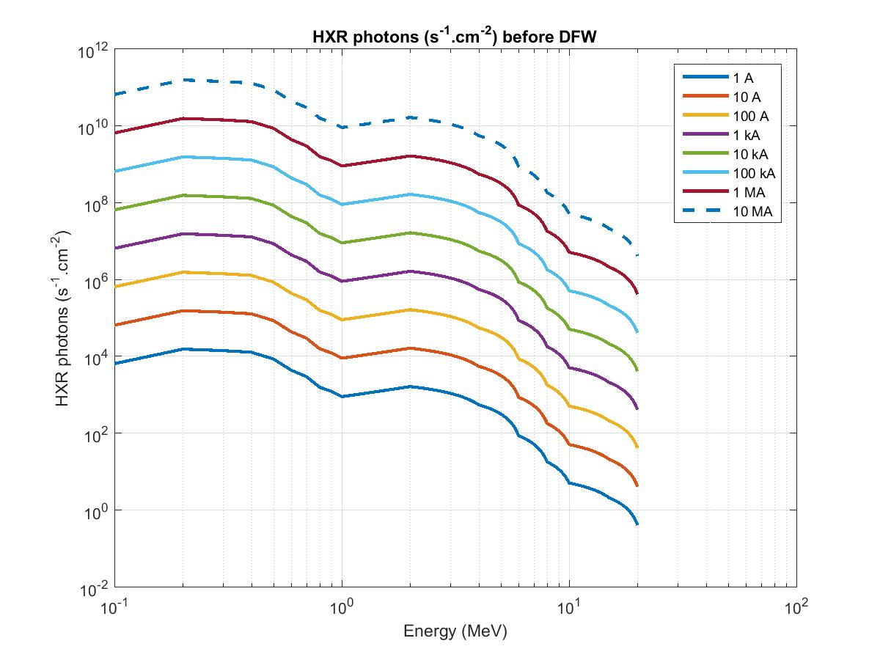
Model runaway distribution function an MCNP calculation
E_{max} = 20 MeV

Slide 16
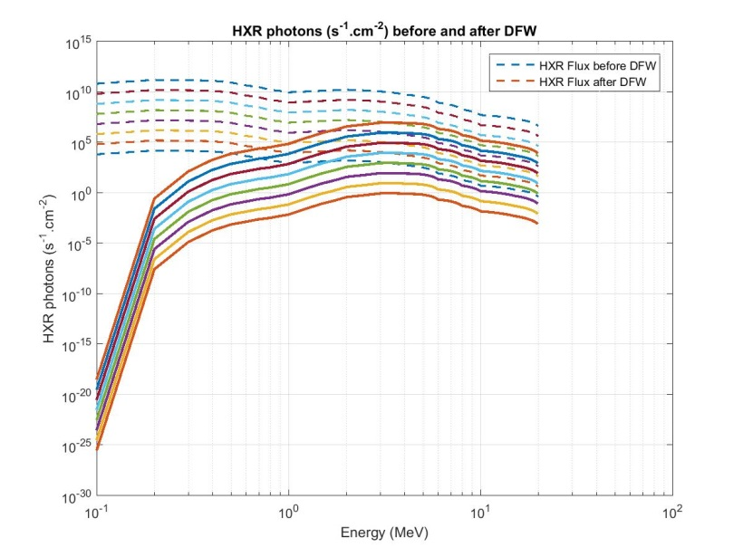
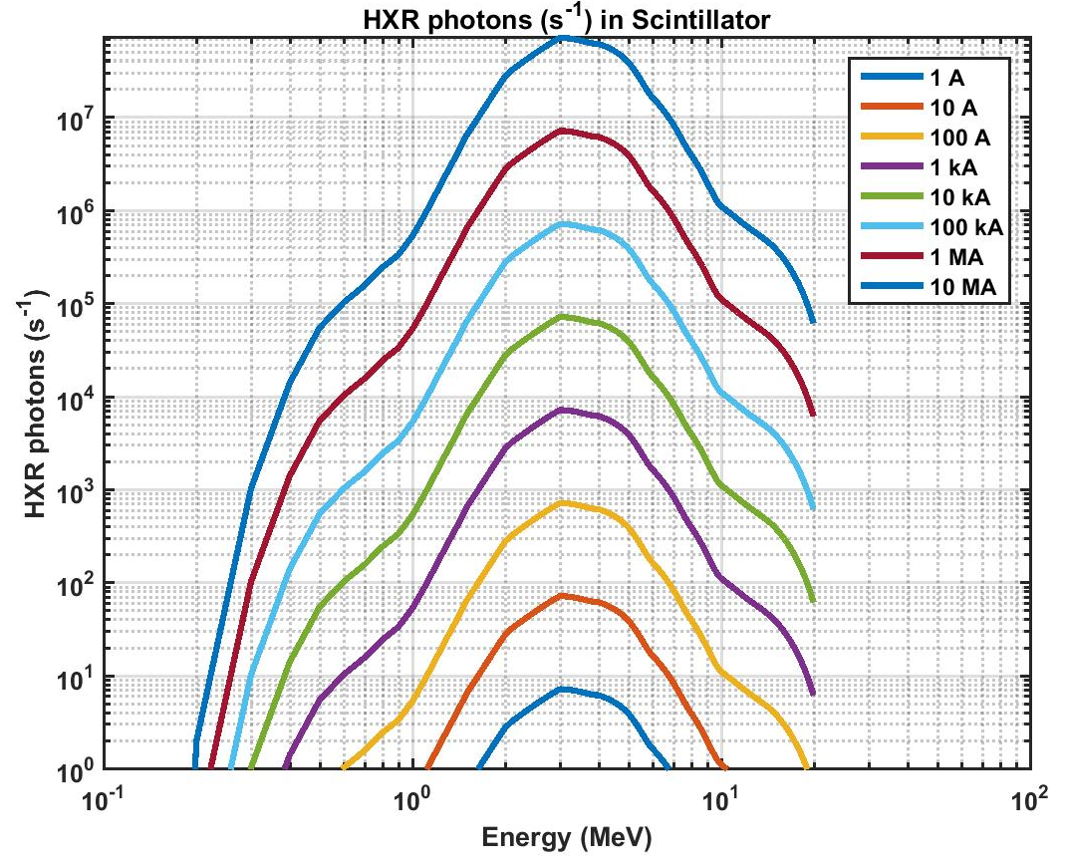
Model runaway distribution function an MCNP calculation
Survived Flux at DFW=30 cm
Attenuation
through DFW

Slide 17
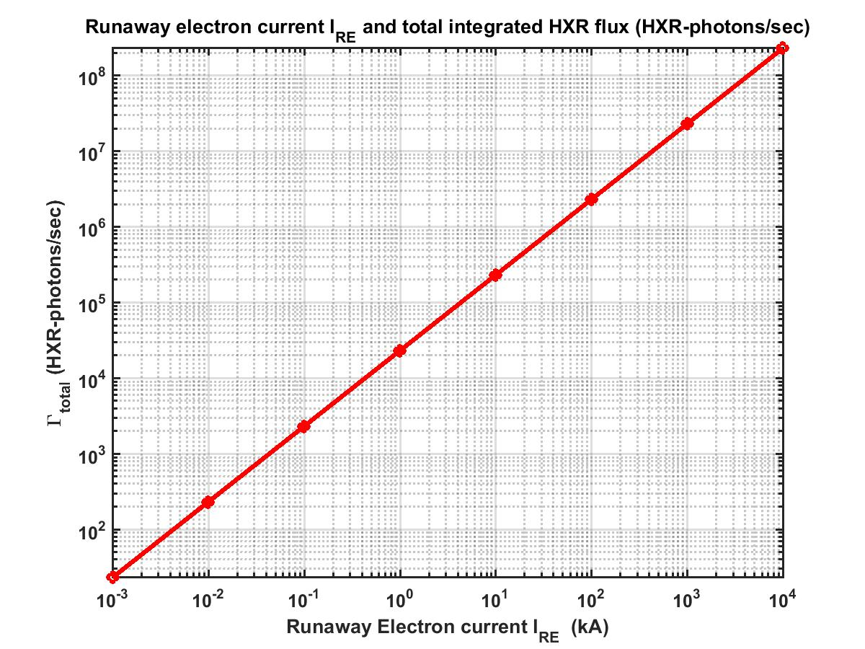
Possible dynamic range for the measurements
Saturation limit
in counting mode
Suggested 10 kA
Detection threshold
PMT-in current
mode
PMT-in Counting
mode
At DFW=30 cm

Slide 18
Measurement specification from HXR-monitor
SR. No. | System specifications | Value / compliance
1 | Mode of the operation | Counting mode Current mode
2 | HXR Energy range to be detected (E_{HXR}) | ~0.5 MeV to 20 MeV
3 | HXR counts time resolution (Δt) | 1 ms to 10 ms
4 | HXR Energy spectra (dN/dE) Pulse Height Analysis of recorded counts | ~0.5 MeV to 20 MeV
5 | HXR Energy resolution (ΔE/E) | ~40% (Energy Range: 0.5 ≤ E_{HXR}<1 MeV) ~20% (Energy Range: 1 ≤ E_{HXR}≤20 MeV)
6 | HXR Energy spectra time resolution Δt for dN/dE | ≥10 ms (depending upon counting statistics)
7 | Maximum count rate (in counting-mode configuration) | 1.0e+6 CPS Up to 1.0e+7 CPS (post analysis algorithm)
8 | HXR-signal (in current-mode configuration) | Voltage signal showing existence of runaway electrons in plasma

Slide 19
Summary
Preliminary design analysis of the ITER HXR-Monitor is carried out which is a first plasma diagnostic
The proposed design meets the measurement requirements within the reasonable margins and has a broad dynamic range
Further detailed design and optimization work is under progress for subsequent design phase

Slide 20
Thank you

