Slide 1





Run-away studies in JET
E. Joffrin, L. Baylor, M. Lehnen, C. Reux and JET Contributors*
With contribution from O. Ficker, E. Nardon, R. Paprok, V. Riccardo

Slide 2
Outline
JET disruption mitigation system (DMS) overview
Summary of JET results on run-away mitigation
SPI overview design
JET run-away programme objectives in 2018

Slide 3
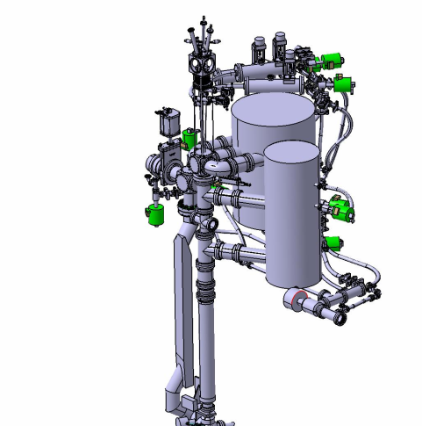

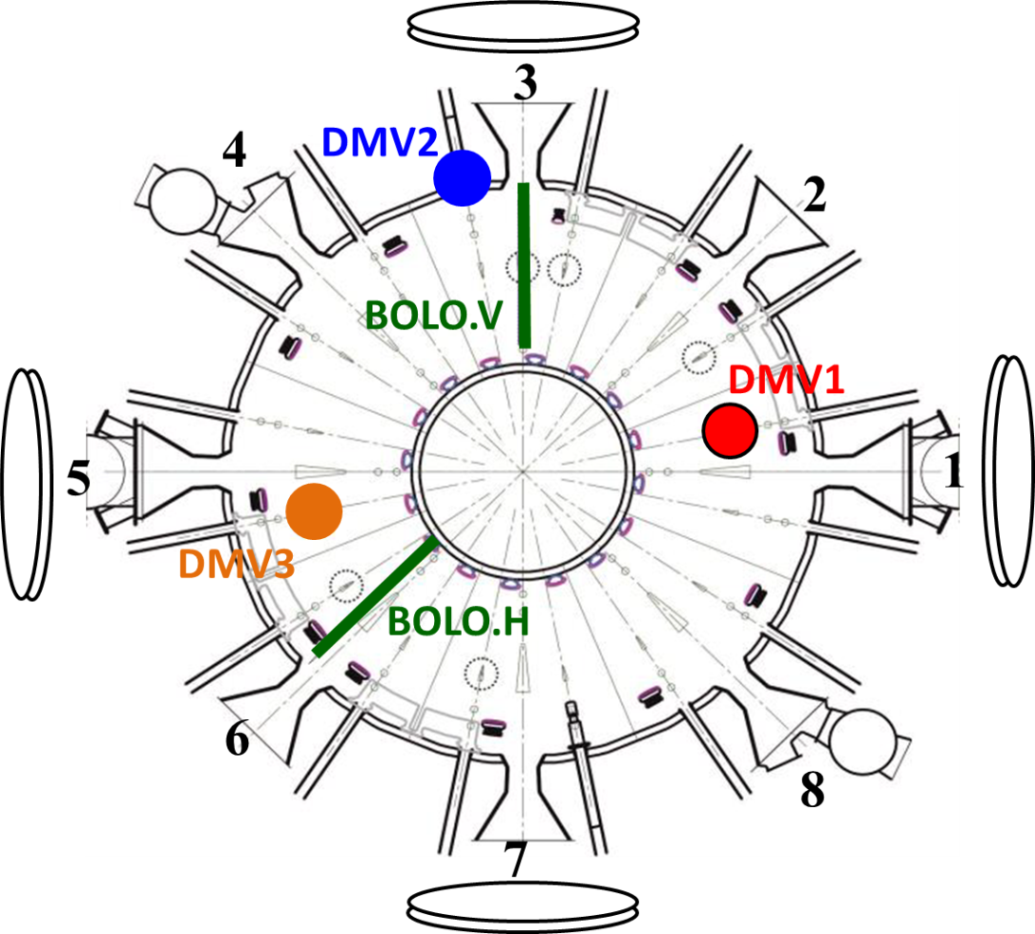
JET is equipped with a comprehensive disruption mitigation system (DMS)
DMV1 | Upper port | 4.6m to LCFS
DMV2 | Horiz. port | 2.8m to LCFS
DMV3 | Upper port | 2.4m to LCFS
The fast camera can be equipped with an Argon filter to measure its penetration into the plasma
Error field correction coils
SPI in lieu of DMV1
Fast camera
Massive gas injection mandatory in JET for:
Ip > 2MA OR
W_{TH}+W_{MAG} > 5MJ
+ g-ray spectroscopy
+ Hard-Xray
Joffrin IAEA 2016

Slide 4
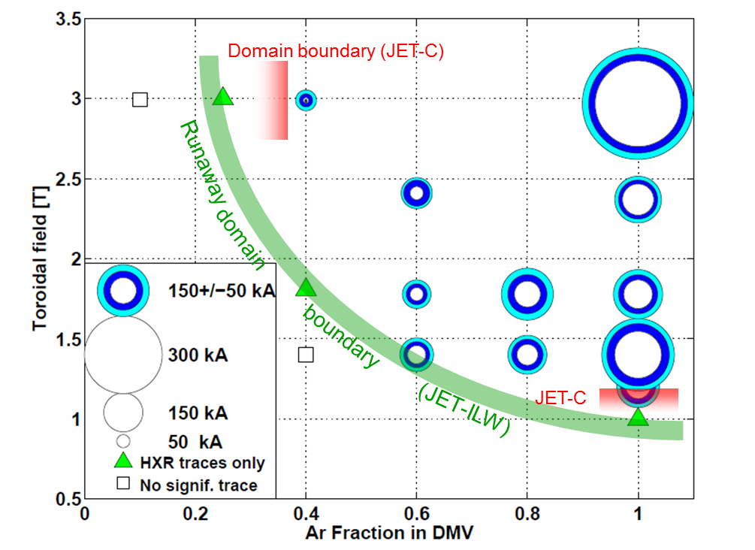
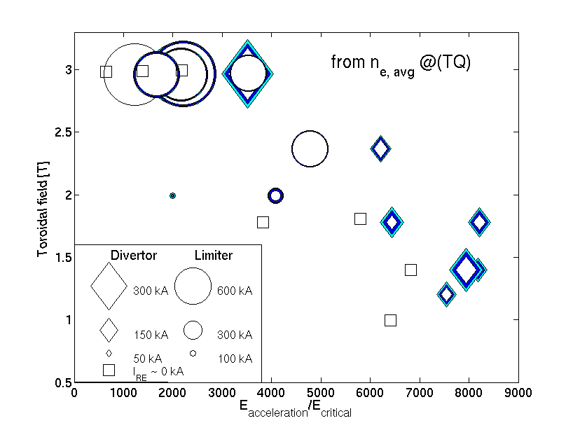
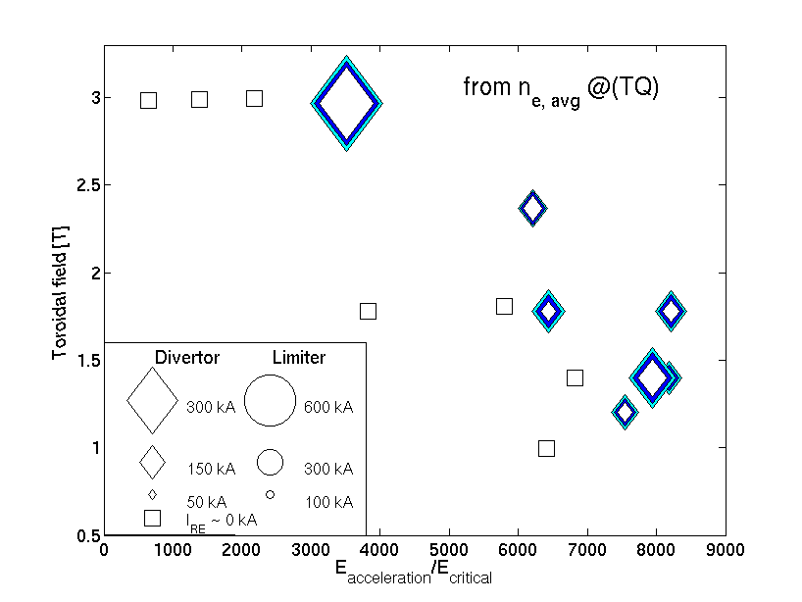
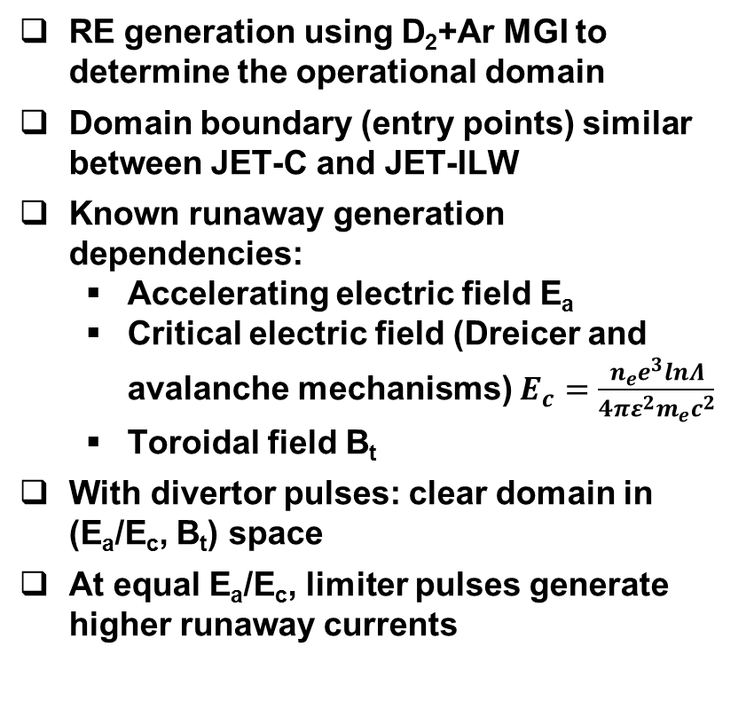
Run-away existence domain in JET.
RE generation using D₂+Ar MGI to determine the operational domain
Domain boundary (entry points) similar between JET-C and JET-ILW
Known runaway generation dependencies:
  Accelerating electric field E_{a}
  Critical electric field (Dreicer and avalanche mechanisms) $E_{c}=\frac{n_{e}e^{3}lnΛ}{4πε_{}^{2}m_{e}c^{2}}$
  Toroidal field B_{t}
With divertor pulses: clear domain in (E_{a}/E_{c}, B_{t}) space
At equal E_{a}/E_{c}, limiter pulses generate higher runaway currents
RE/no-RE boundary for divertor shapes
Strong dependence of RE generation on vertical position
Reux Nuc Fus 2015

Slide 5
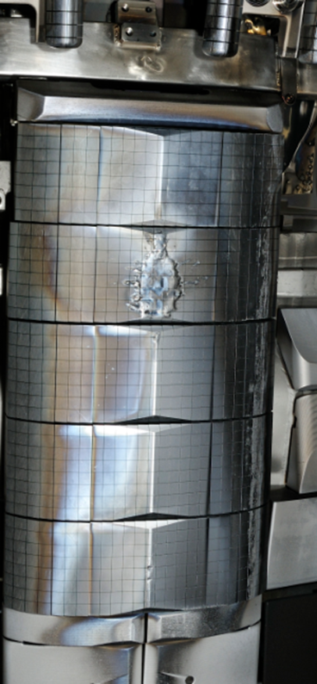
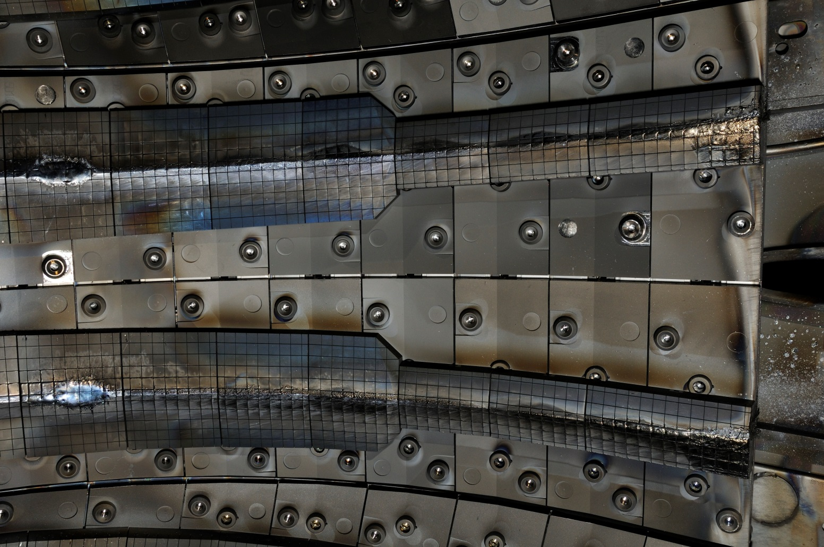
Example of JET on Be component damages in JET
spray of droplets stuck on wall
Bubble-like damage to the upper dump and Inner Guard limiter place from run-aways localized toroidally
Outer ends beryllium protection tiles all damaged in a similar way toroidally

Slide 6
In JET Massive gas injection is also inefficient in mitigating run-aways
Ip (MA)
Massive gas injection inefficient at JET for mitigating RE for different gas (Ar, Kr, Xe,…) and pressures.
Run-away beam can be mitigated by MGI in DIII-D, Tore Supra and ASDEX Upgrade.
Hypotheses: the machine size or the surrounding plasma has a screening effect.
DMV1
DMV2
Vertical displacement (m)
Soft X-ray
➔ This hypothesis has been tested on JET in November 2016: analysis on-going
C. Reux, Nuc. Fus 2015
Time (s)

Slide 7
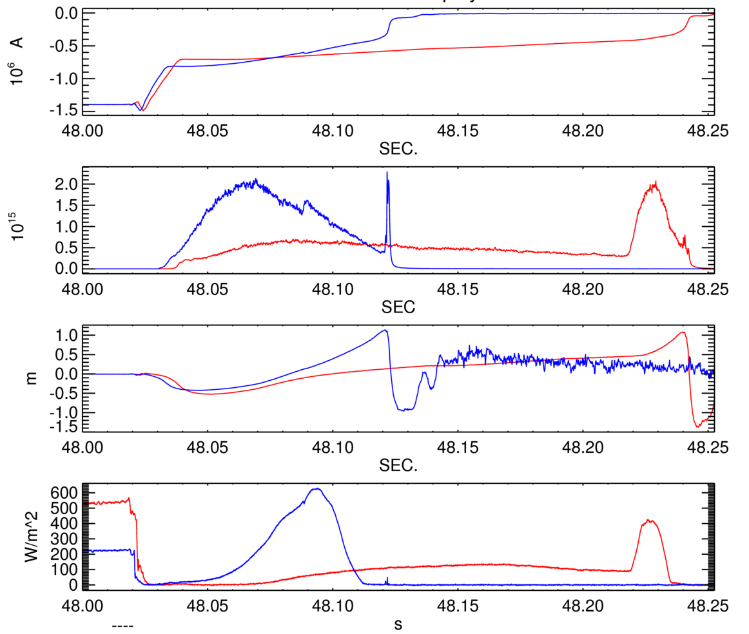
In JET Massive gas injection is also inefficient in mitigating run-aways
DMV1 was previously used to trigger runaway beams at JET (limiter configuration), DMV1 low pressure argon
Recent experiments has proved that it is also possible with DMV3 (mid-plane)
#92448(DMV1 2 bar.l)
Longest post-disruptive runaway beam at JET-ILW with DMV3 (190 ms!)
Much less gas injected to trigger the beam: possibly different generation conditions or runaway energies?
To be confirmed with more statistics.
Possible signs of enhanced mitigation with a second puff (DMV2 later in the beam phase)
Role of the background plasma? Or RE energy ?
#92459 (DMV3 63 mbar.l)
neutrons
Vertical position
HXR Horiz. Chord 10
➔ Analysis still on-going
Reux, 2016

Slide 8
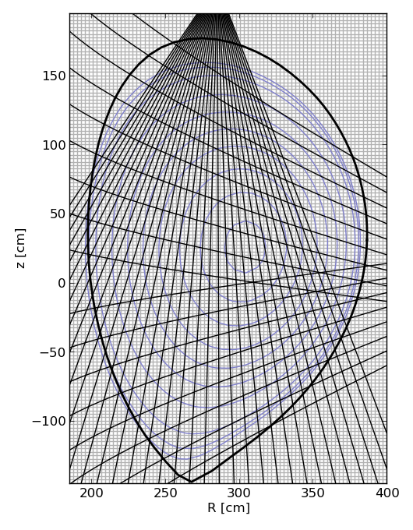
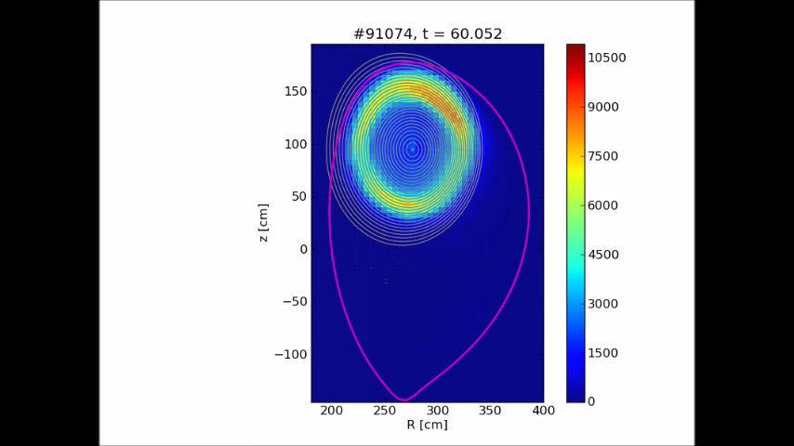
JET – SXR tomography of 2nd DMV
Soft X-ray
1-20 keV, braking radiation of electrons, line radiation
RE beam – gas interaction
Tomography
MFR - Tikhonov regularization
2 cameras used
Hollow profile – gas cannot get into the beam??
O. Ficker

Slide 9
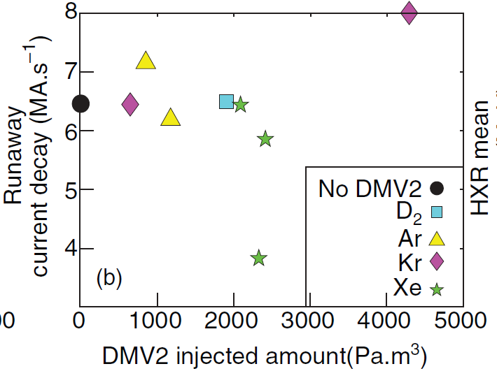
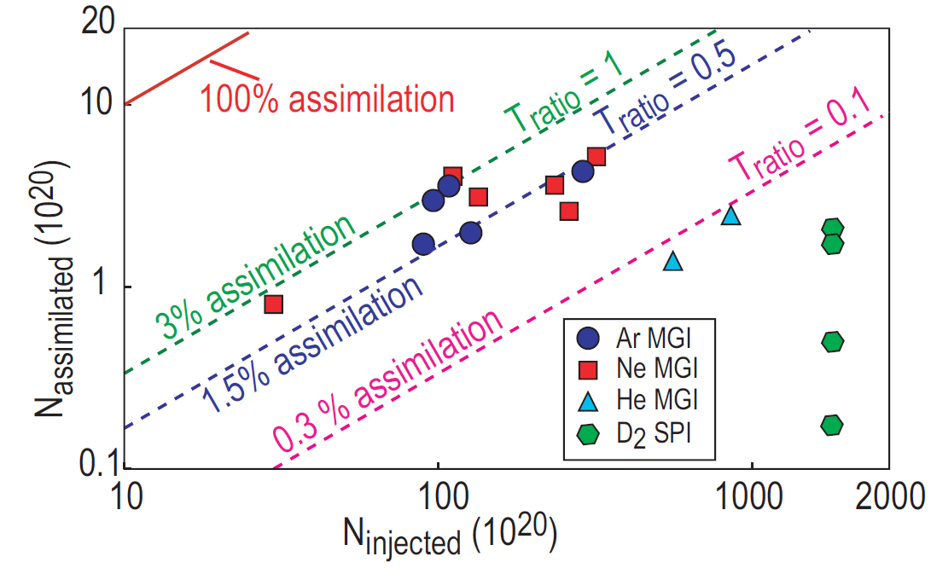
Low assimilation reported using DMV
Penetration of impurities is likely to depend on
  Injection parameters (especially injection geometry)
  CQ / RE plasma parameters
Low assimilation reported from experiments
  JET: f_{assim} = 0 (from current decay and n_{e})
  DIII-D: f_{assim} = 1 % range (from pressure balance)
JET 2nd injection
DIII-D 2nd injection
C. Reux et al., Nucl. Fusion 2015
E.M. Hollmann et al., Nucl. Fusion 2013

Slide 10
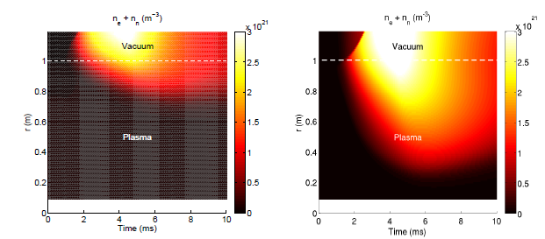


Simulation are suggesting a role of the background plasma
  Works on Tore Supra [Saint-Laurent FST 2012], DIII-D [Hollmann NF 2013] and ASDEX Upgrade [Pautasso EPS 2015] but no effect on JET! [Reux et al., NF 2015]
  A possible explanation supported by simulations: gas cannot reach RE beam because it is “shielded” by the high density (n_{e,bg} ~ 10²⁰ m⁻³) background plasma
Free + bound electron density vs. time and radius
n_{e,bg} = 10²⁰ m⁻³
n_{e,bg} = 10¹⁹ m⁻³
Nardon EPS 2017

Slide 11
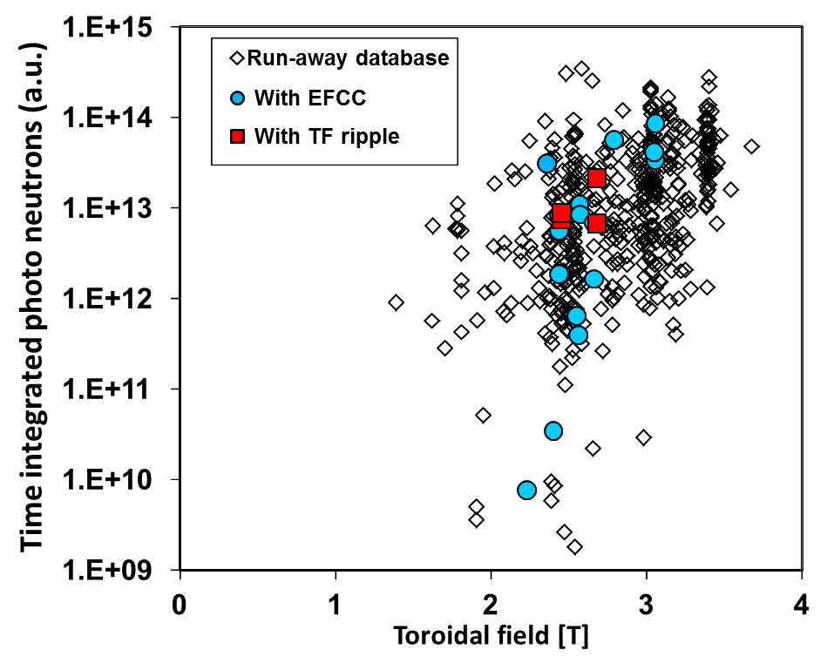
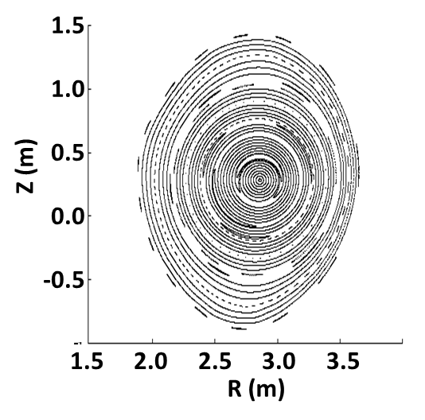
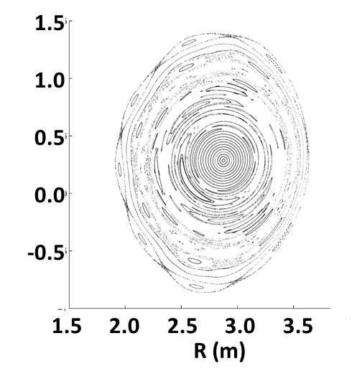
In JET magnetic perturbations are inefficient in mitigating run-aways
48kAt (Max EFCC current)
96kAt
R. Paprok, PPCF 2016
V. Riccardo, PPCF 2009
EFCC and TF–ripple do not lead to a reduction of RE population in JET
Relativistic (5-20MeV) electron particle motion modelling predicts no stochastization of trajectories at maximum EFCC coil currents.

Slide 12
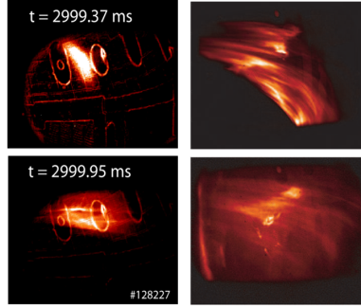

Shattered pellet injected tested on DIII-D
Pellet injection (SPI) yields a faster and more efficient particle delivery than massive gas injection (MGI)
SPI tested on DIII-D:
MGI
SPI
(N. Commaux)
Shattered pellet injection has been tested on DIII-D and leads to deeper penetration and higher density assimilation than massive gas injection.

Slide 13
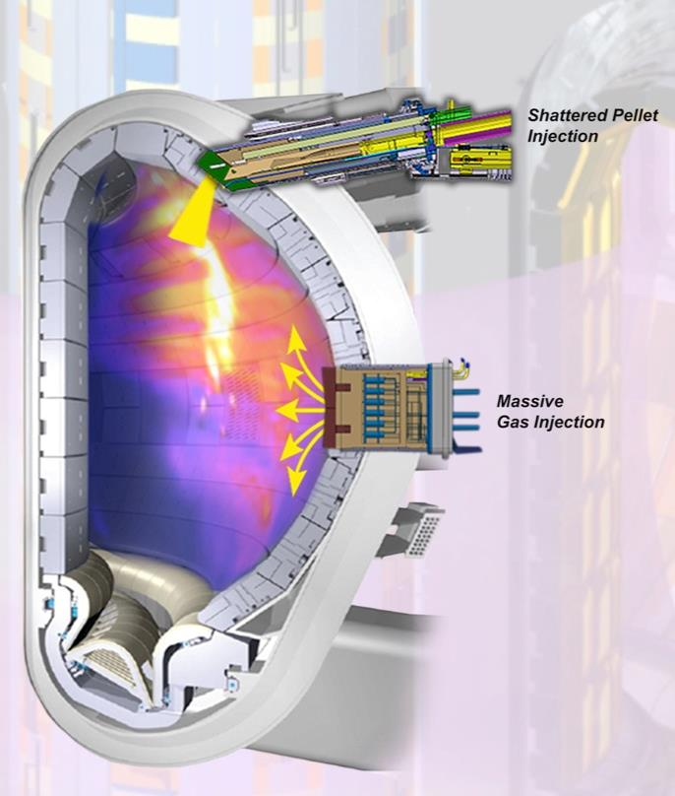
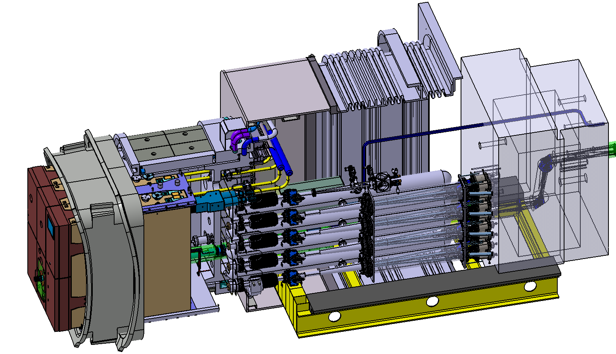
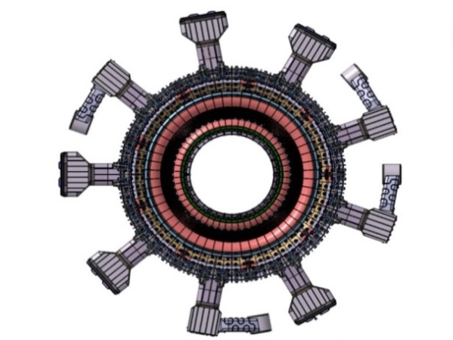
ITER DMS design overview
Baseline System: Shattered Pellet Injection
Thermal and electromagnetic load mitigation (TLM):
Ne < 8 kPam³, pre-TQ injection (back-up: early CQ)
Runaway electron suppression (RES):
Ar, Ne < 100 kPam³, D₂ < 50 kPam³, pre-TQ for RE
suppression, post-TQ for runaway energy dissipation
Significant gaps in physics basis especially on RE mitigation
and urgent need for R&D has been identified at the
IO Workshop March 2017, report available.
Upper Port DMS
Equatorial Port DMS
10ms warning time required
Upper Port No.8
SPI DMS (TLM)
Equatorial Port No.8
SPI DMS (TLM + RES)
MGI DMS (TLM) for non-nuclear operation
Upper Port No.14
SPI DMS (TLM)
Upper Port No.2
SPI DMS (TM)

Slide 14
Recent ITER STAC statement
STAC endorses the IO strategy to have shattered pellet injection (SPI) as the primary baseline Disruption Mitigation System (DMS). However, there are concerns that the planned SPI systems may not be able to mitigate runaway electrons, which may cause serious damage to first wall components.
Since the DMS is of utmost importance for ITER, it should receive the necessary priority over other sub-systems as needed to achieve its technical requirements. The DMS design should not be frozen prematurely and design flexibility should be retained including alternate port allocation, depending on the outcome of the forthcoming DIII-D and JET experiments.
The STAC recommends that the IO work with the DAs and the ITPA to define an efficient framework for the coordination of the DMS R&D.

Slide 15

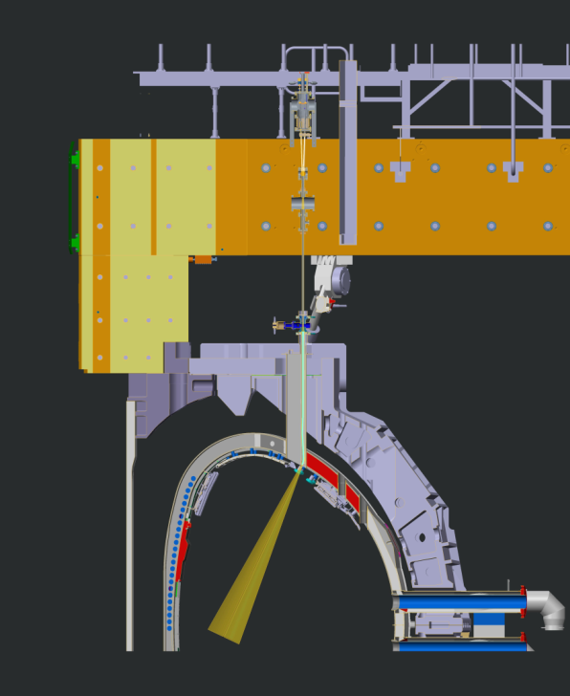
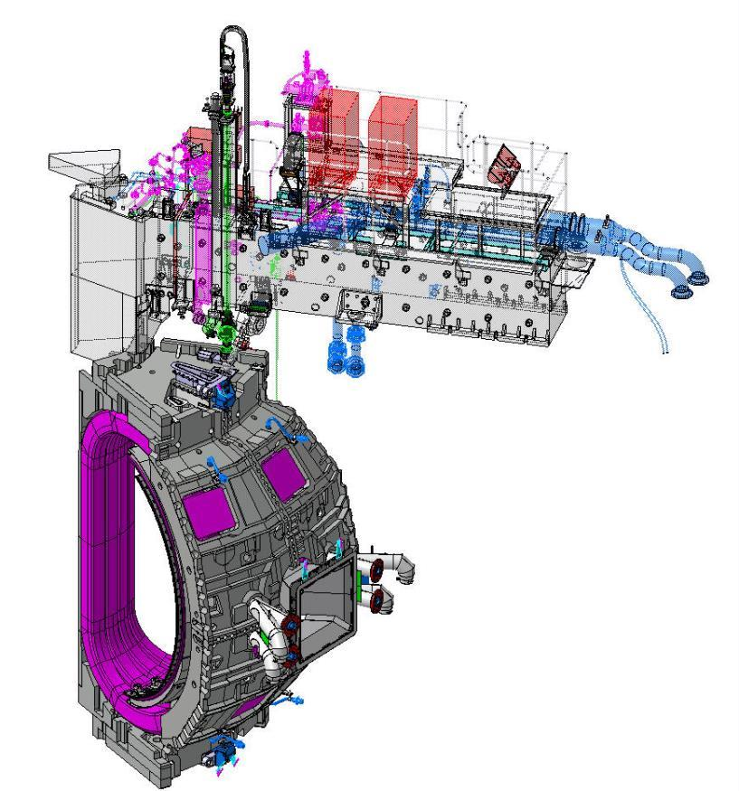
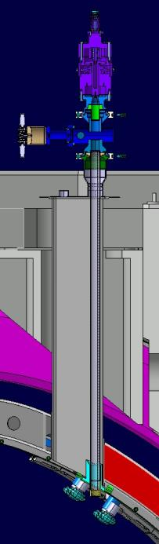
SPI installation on JET
Contractual framework: installation + research programme (17/01/2017)
1- European Atomic Energy Community (EURATOM): EUROfusion + CCFE
2- US DOE: ORNL + US ITER Project Office
3- ITER Organisation
SPI to be located on top of machine in place of DMV1
SPI shatter tube fits inside vertical injection line with bend just before entering the plasma.
Must be inserted from above which means a 40mm opening.

Slide 16
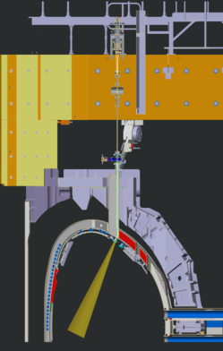
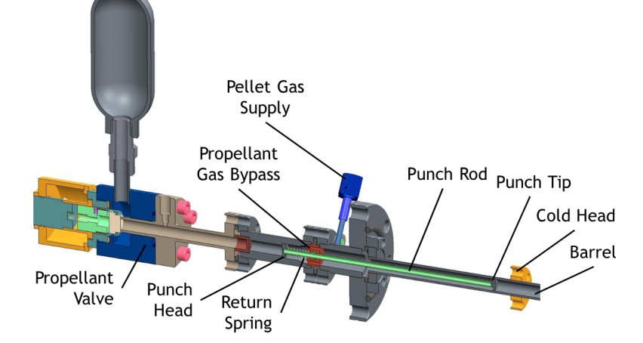
SPI main components (I): the injector
Injector

Slide 17
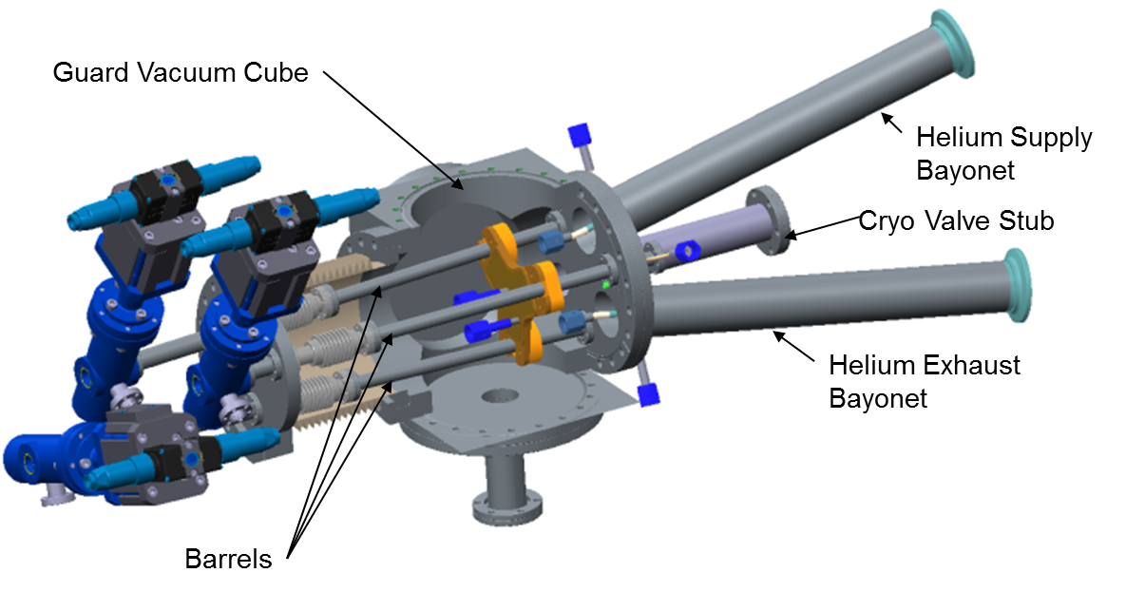
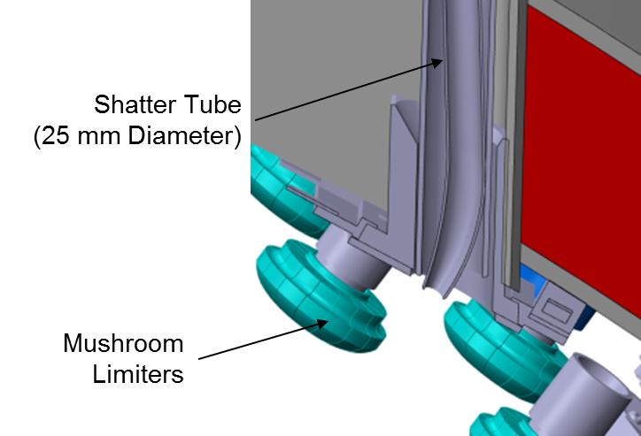
SPI main components (II): Pellets forming component and tube
Pellet forming components
Shatter Tube

Slide 18
SPI: range of pellets / particle quantities
Barrel No | Diameter [mm] | Length [mm] | Expected range of pellet speed [m/s] | Ar quantity | Ne quantity | D2 quantity
1 | 12.5 | 31.25 | 150-200 | 9x10²² | 1.6x10²³ | 2.3x10²³
2 | 8.0 | 12.0 | 150-200 | 1.5x10²² | 2.6x10²² | 3.6x10²²
3 | 4.5 | 5.8 | 250-500 | - | 4.0x10²¹ | 5.6x10²¹
Different pellet sizes for varying injection quantities to compare with MGI efficiency (~10²¹)
Option to vary the impurity quantity in the pellet by adding deuterium with accuracy below 1%,
Larger quantities of up to 10²³ are required to perform the studies on runaway energy dissipation.
The maximum argon quantities tested with MGI at JET were around 2x10²³.
Note: the SPI is not DT compatible.

Slide 19
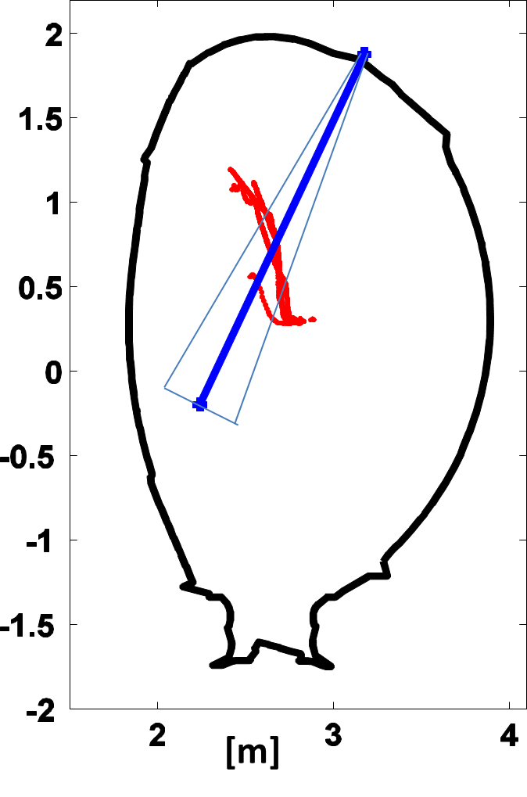
Run-away beam trajectory in the vacuum vessel
Trajectory of the run-away beam current centroid measured by the magnetics.
All data are taken from the current quench time until the end of the run-away beam.
The beam moves towards the upper –inner board side (where the impacts are also observed)
The planned cone for the SPI is crossed by the trajectory of the runaway
All these examples have used DMV1 for generating the RE beam.
In November 2016 it has been demonstrated that DMV2 or DMV3 are able to generate a upward-moving beam.
Action is presently on-going to improve the RE beam control in the chamber (2017 Task)

Slide 20
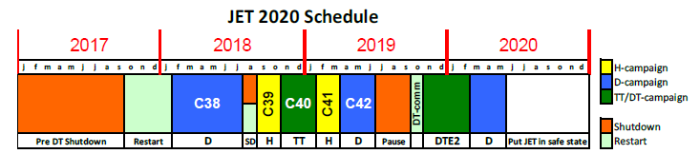
SPI at JET: programme for 2018 campaigns
Disruption mitigation is one of the top three priorities in the present JET programme of EUROfusion. It will remain so whilst testing SPI on JET.
The objectives of the experimental studies are as follows (as per the contract)
Assess the efficacy of SPI on runaway energy dissipation of a full blown runaway electron beam
Define the parameter domain for which pre-thermal quench injection with SPI fully prevents runaway electron generation; and
Assess the efficiency of SPI in preventing heat loads during the thermal and the current quench and in controlling the current quench rate.
➔ The maximum number of experimental shifts allocated to testing SPI at JET is 16.

Slide 21
JET work organization and agenda
2 Task forces: Integrated Operating scenario (IOS): J. Mailloux, M. Barruzo, M. Romanelli
Physics and Technology for ITER (PTI): E. Joffrin, D. Borodin, J. Hillesheim, H. Weisen
1- Prepare scenarios for fusion performance and alpha particle physics.
2- Determine the isotopes dependence of H-mode physics, SOL conditions and fuel retention.
3- Quantify the efficacy of SPI versus MGI on runaway and disruption energy dissipation and extrapolate to ITER.
3 Top objectives:
12/05/2017: Call for proposal (including the SPI). Members of this PB also recipients
04/08/2017: Deadline for receiving experiment proposals
04/09/2017: General task force meeting: discussion of priorities of proposals.
End Oct 2017: Plasma restart
Mid Nov 2017: Selection of Scientific coordinator and staffing.
Mid Dec 2017: Staffing finalised
12/02/2017: Start of C38 deuterium campaign until 27/07/2017
http://users.euro-fusion.org/tfwiki/index.php/Proposals_C38_to_C42

Slide 22
Conclusions / prospects
For the next 2018-19 experiment campaigns, JET ITER like Wall will be equipped with a comprehensive DMS for studying disruptions and run-away for ITER.
It is therefore essential that the EU and US community working on run-aways put together their efforts in this Programme for contributing to the safe operation of ITER.
An on-going analysis task in the present JET programme is already preparing the analysis and modelling tools for these experiments: you are welcome to join (T17-13: SC: C. Reux).
The JET programme is strongly encouraging your participation and ideas of experiments for 2018-19

